Slide 2
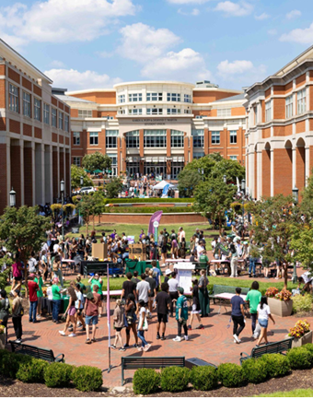
UNC Charlotte’s International Population
Semester | Enrolled International Students | OPT & STEM-OPT | Visiting Scholars & Faculty | Total Served by ISSO
Spring 2025 | 1,807* | 1,626** | 150 | 3,583
*Degree seeking 1,590 + Exchange 20 + Other visa types 161 + ELTI 36 = 1,807
**Optional Practical Training is post-completion employment authorization in the U.S. but students are expected to maintain F-1 compliance

Slide 3
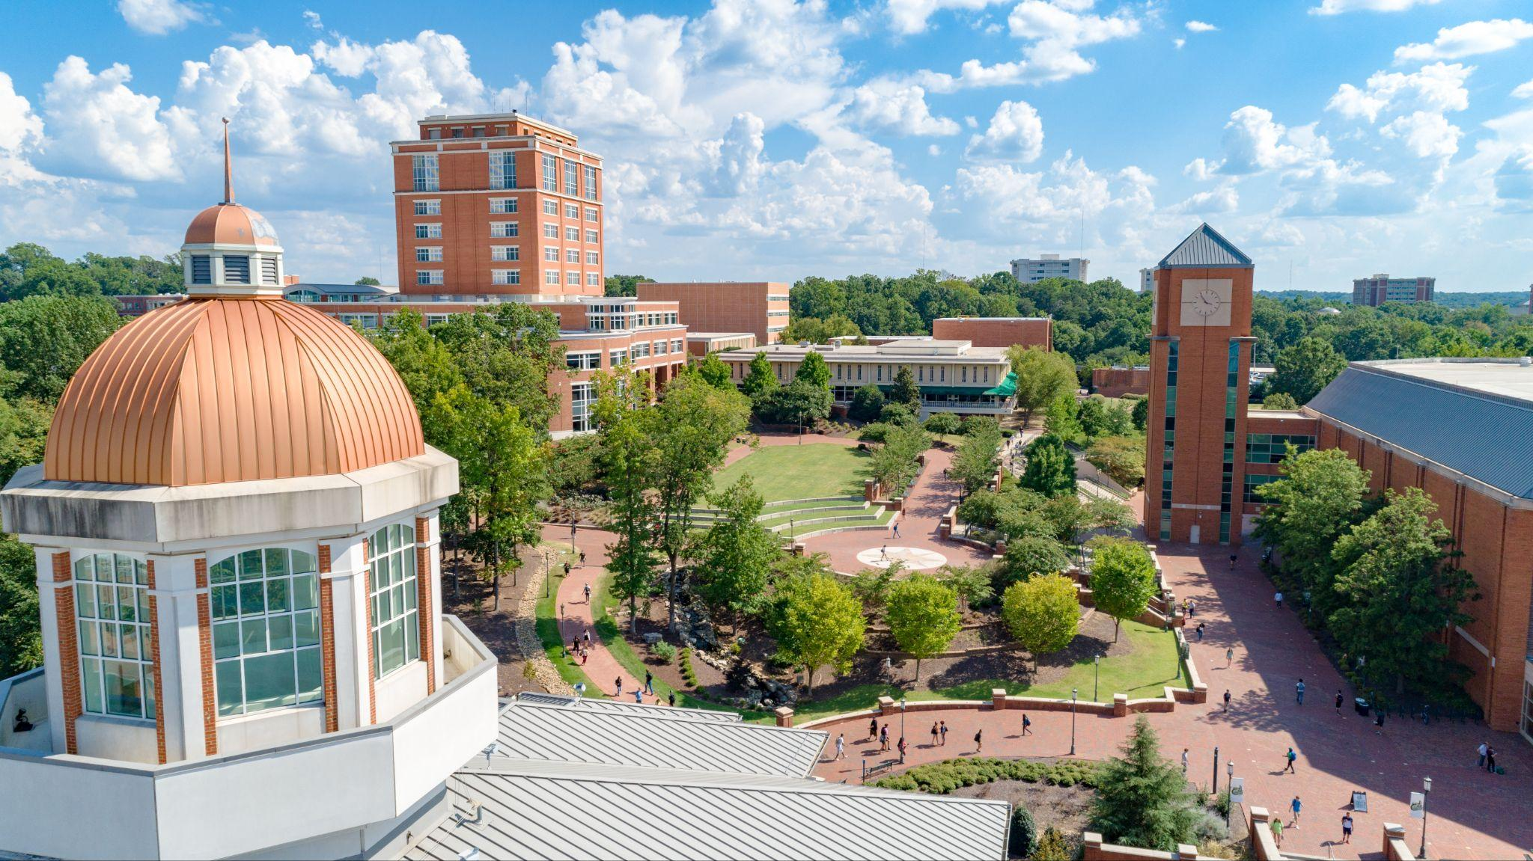
ISSO Programs & Services
Immigration & advising services
Issuance of immigration documents, I-20 (F-1) & DS-2019 (J-1)
Daily advising via email, phone & in-person
Monthly newsletters
Immigration workshops, including:
Curricular Practical Training (CPT)
Optional Practical Training (OPT) workshops
Programming & connection
International Student & Scholar Orientation
International Coffee Hour
Friendship & Culture Exchange (FACE)
Cultural Ambassador Speaker Panels
Cultural events/excursions

Slide 4
Immigration Compliance (F-1, J-1, H-1B, O-1, TN)
ISSO Responsibilities
Inform, educate, and alert students & scholars on immigration requirements and deadlines
Submit mandatory reports throughout the year to U.S. Immigration on behalf of institution
Regularly monitor & analyze changing immigration regulations
Provide and receive ongoing training through professional association (NAFSA: Association of International Educators); benchmark with peer institutions
Advocacy
International Student & Scholar Responsibilities
Students and scholars are responsible for maintaining valid immigration status for the duration of their studies/research

Slide 5
J-1 vs. H-1B Visa Sponsorship
J-1 = temporary, non-tenure track research or teaching positions; can be funded by institution or individual; 3 weeks to 5 years max, depending on category; 3-5 month lead time due to internal and external compliance-related processing; no USCIS fees
H-1B = permanently-funded teaching or research positions (‘specialty occupation’; 3 yrs with possibility of 3 yr extension; 4-6 month lead time due to internal and external compliance-related processing; USCIS fees of $3,765 (subject to change)
Sponsorship requests submitted to ISSO by Business Officers/Business Services Coordinator in coordination with chair/supervisor: ISSO training provided once/semester
UNC Charlotte’s Employment-Based Immigration Sponsorship Guidance: reviewed by Office of Legal Affairs, Office of Provost, and Human Resources

Slide 6
Pathway to U.S. Permanent Residence
Permanently-funded teaching/research positions qualify (after 1 year of employment)
Sponsorship is always at discretion of department chair
Two main employment-based pathways plus one self-petition option
Lengthy, complex process involving multiple government agencies; led by ISSO (around 2 years)
Important to differentiate between ‘pathway to PR’ and actual green card
Important to differentiate between H-1B ‘visa status’ and ‘pathway’ to PR

Slide 7
Questions?

