Slide 1
Faculty Dining Updates
Faculty Council
11/21/24

Slide 2
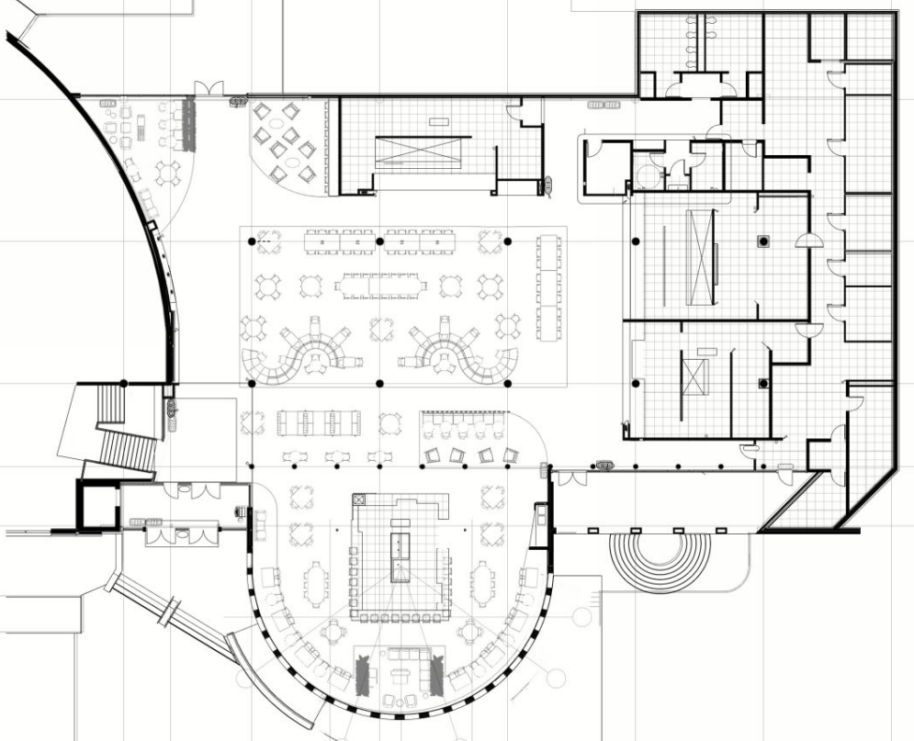
Upper Prospector Renovation
Project Schedule
12/6/24 – Upper Prospector Closes
1/13/25 – Food Truck Village
8/1/25 – Upper Prospector Reopens
Four New Concepts:
Qdoba
Panda Express
The Halal Shack
The Oasis
Notes:
Project Schedule
12/6/24 – Upper Prospector Closes
1/13/25 – Food Truck Village
8/1/25 – Upper Prospector Opens
Four New Concepts:
Qdoba
Panda Express
Halal Shack
Oasis

Slide 3
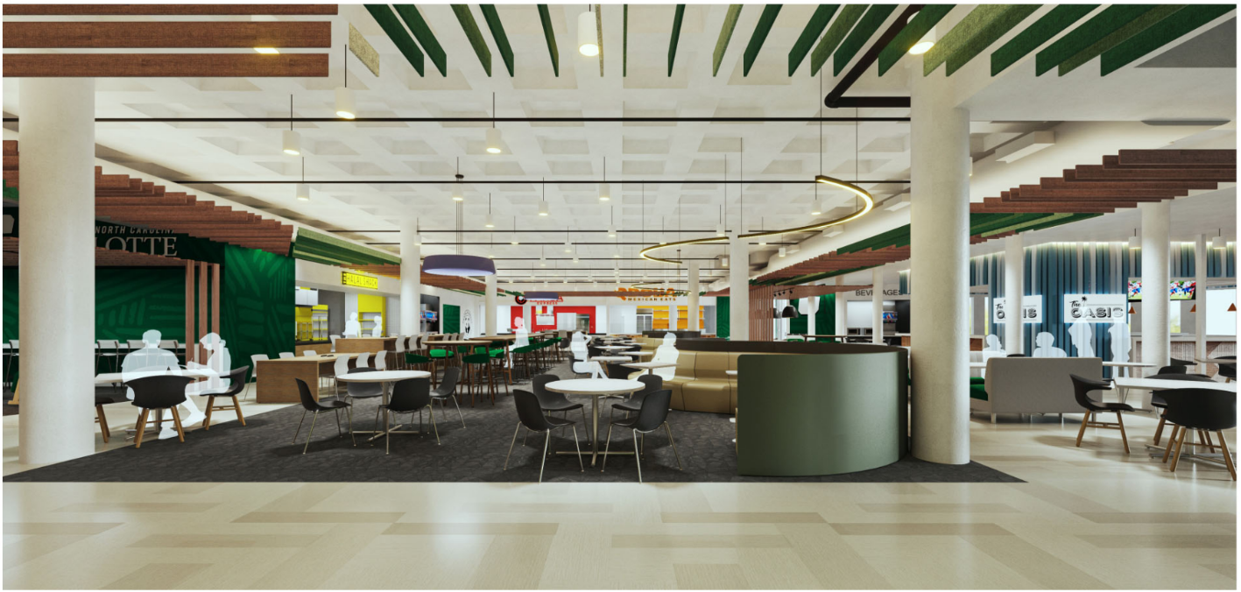
Upper Prospector Renovation
Notes:
Design elements:
Loungy, but functional space
A place for commuters to hang out
Couches, rockers, high-tops, traditional seating, etc.
Lots of power for charging capabilities
Video wall
TVs @ bar

Slide 4
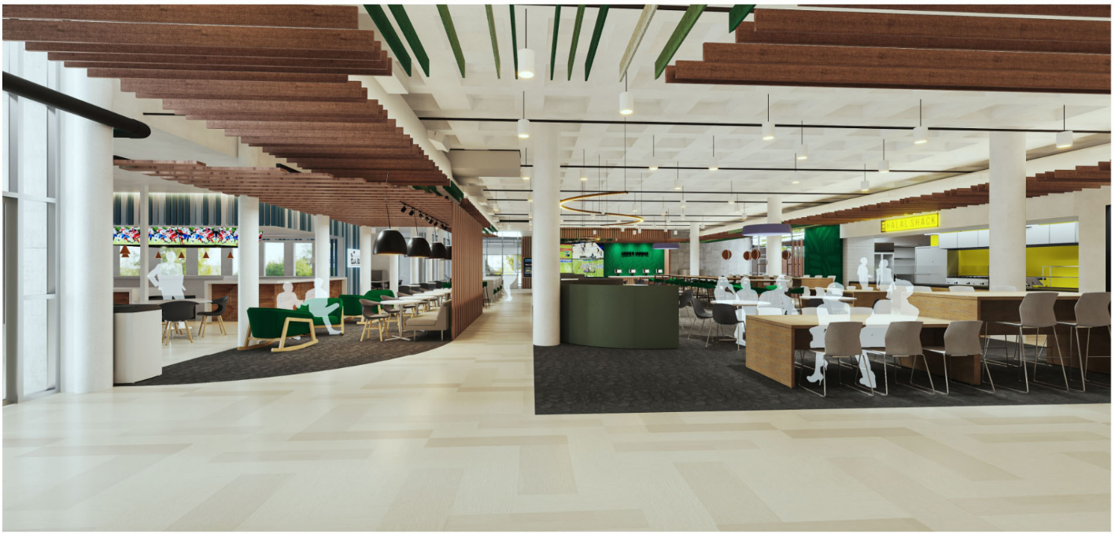
Upper Prospector Renovation
Notes:
Design elements:
Loungy, but functional space
A place for commuters to hang out
Couches, rockers, high-tops, traditional seating, etc.
Lots of power for charging capabilities
Video wall
TVs @ bar

Slide 5
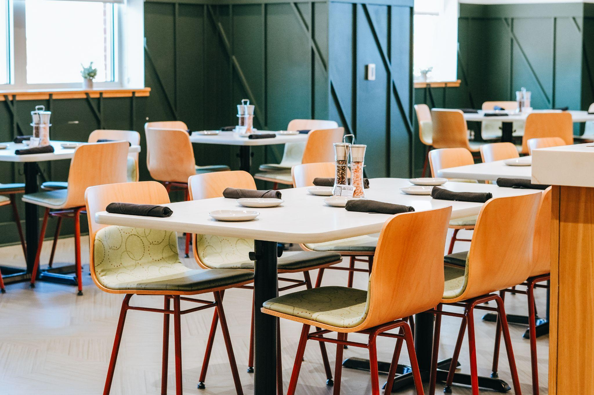
The Bistro
Open daily from 11a to 2p; $14.75 per person
Promotions with discounted rates offered throughout the semester
Hybrid service offered with served drinks/soup/bread with a buffet lunch and dessert
After hours reservations available for private/departmental events
Special events hosted monthly
704-687-7056
Notes:
Social 704 = 762k meals (22% Increase over Crown Commons)
207k More Meal Swipes Over PY
193,000 Pizzas Made
346,000 Burgers Served
45,000+ Robot Deliveries
7-Student Interns w/Chartwells (2 Stayed w/Chartwells as FTEs @ UNCA & UNCG
Intern Business Proposal Created the Auntie Anne’s Cart!

Slide 6
Five Block Feast
5 meals for $40
Meals are redeemed at SoVi during fall/spring semesters; Social 704 in summer
Purchase the plan in My UNC Charlotte under Tools and Resources–49er Card Id
Available to all current faculty and staff
Notes:
Social 704 = 762k meals (22% Increase over Crown Commons)
207k More Meal Swipes Over PY
193,000 Pizzas Made
346,000 Burgers Served
45,000+ Robot Deliveries
7-Student Interns w/Chartwells (2 Stayed w/Chartwells as FTEs @ UNCA & UNCG
Intern Business Proposal Created the Auntie Anne’s Cart!

Slide 7
Questions?
Jody Thompson
Director of Auxiliary Services
7-7349
jthom373@charlotte.edu
Notes:
Social 704 = 762k meals (22% Increase over Crown Commons)
207k More Meal Swipes Over PY
193,000 Pizzas Made
346,000 Burgers Served
45,000+ Robot Deliveries
7-Student Interns w/Chartwells (2 Stayed w/Chartwells as FTEs @ UNCA & UNCG
Intern Business Proposal Created the Auntie Anne’s Cart!

