Slide 1



SUPPORTING THE HIGHEST
PRIORITY GOALS & OBJECTIVES OF
Notes:
It has been our privilege to serve your academic community over the years and our true pleasure to serve your community. We reaffirm our commitment to building upon our bookstores’ successes by offering strategic programs that will improve the access and affordability of course materials. Our efforts will ensure the continuation of a viable, robust and engaging omni-channel bookstore experience for many years to come.

Slide 2
STUDENT PULSE RESULTS:
STORE SATISFACTION
Notes:
Retail Insights
The increases around in-store activity seen in 2022 have stabilized – trends remained consistent with last year. In-store continued to be the top engagement method with the bookstore, as well the most preferred channel for shopping for emblematic merchandise. Course materials and general merchandise continued to be the top reasons for store visits. While students most often purchased their course materials from the bookstore online only, in-store purchases (whether in-store only or in addition to online) represented 55% of purchases.
Our bookstores maintain strong performance among students. The majority gave high ratings for their bookstore's performance and had high levels of satisfaction across many aspects of the shopping experience (both in-store and online). Students continued to place high importance on having course materials available in the store.
Our bookstores remain a top destination for course materials, school-branded apparel, and graduation products.
Email remains the top communication channel as students look for financial benefits. Students still said email was their primary driver for store visits and preferred communication channel from the bookstore. Sales/discounts continued to be the top content of interest, as well as the top driver for repeat visits. Additionally, students indicated that a loyalty/rewards program would also encourage them visit more frequently.
Academic Insights
Students continue to express strong interest in course material bundling. While well over half of students had all of their materials on their first day, nearly 90% students indicated interest in a course material bundling program. Additionally, three-fourths said they would have somewhat more/much more positive perceptions about their school if such a program was offered.
Our bookstores remain a key destination for course materials. They continued to top the list for faculty recommendations and student purchases – though decreasing slightly vs. 2022. While students most frequently purchased their course materials from the bookstore online only, in-store purchases (whether in-store only or in addition to online) represented 55% of purchases. Consistent with last year, nearly 80% would find purchasing course materials through the LMS convenient, and price match awareness remained an opportunity for improvement.
Students continue to use both print and digital resources. Nearly 60% of students indicated they were using both print and digital course materials during the semester – with an increase in those using digital course materials only vs. 2022. Google and YouTube continued to be popular supplementary resources. Similar to last year, over 80% express interest in supplementary tools – with Homework Solution and Q&A garnering the most interest.

Slide 3
OVERALL CAMPUS STORE SATISFACTION
89%
OF STUDENTS RATED THE BOOKSTORE “GOOD”, “VERY GOOD”, OR “EXCELLENT.”

Slide 4
TOP REASONS FOR VISITING THE BOOKSTORE
88%
VISITED IN-PERSON
TOP 5 REASONS FOR VISITING THE BOOKSTORE
#1 Buy textbooks/course materials for class | 78%
#2 Shop for general merchandise | 59%
#3 Rent textbooks/course materials for class | 53%
#4 Pick up online order | 48%
#5 Shop for gifts | 29%
76%
VISITED THE WEBSITE
73%
of students typically shop for school-branded apparel at the campus bookstore

Slide 5
STUDENT PULSE RESULTS:
COURSE MATERIALS INSIGHTS

Slide 6
INTEREST IN BUNDLING COURSE MATERIALS
INTEREST IN BUNDLING COURSE MATERIALS AND IMPACT ON SCHOOL PERCEPTION
87%
72%
of students would like to access course materials bundled with tuition (and at lower cost than what they are paying when purchasing separately).
of students said they would have a somewhat or much more positive perception of their school if their school offered complete access to all their course materials – for a lower price – that would be included in tuition and/or fees.
COURSE MATERIAL FORMATS CURRENTLY USING
9%
27%
64%
Print
Digital
Both

Slide 7
IMPORTANCE OF COURSE MATERIALS IN THE BOOKSTORE
87%
90%
79%
of students said it was important to have textbooks/course materials available at the bookstore
of students were able to buy all course materials at the campus bookstore
of students would find it convenient to purchase course materials through LMS

Slide 8
WHERE STUDENTS PREFER TO PURCHASE THEIR COURSE MATERIALS
FACULTY RECOMMENDATIONS FOR PURCHASING TEXTBOOKS/COURSE MATERIALS
WHERE STUDENTS ACTUALLY PURCHASED TEXTBOOKS/COURSE MATERIALS
74%
36%
68%
32%
Campus Bookstore
Amazon
Campus Bookstore
Amazon
HOW STUDENTS PURCHASED COURSE MATERIALS FROM THE BOOKSTORE
18%
58%
23%
In-store
Online
Both

Slide 9
NINER COURSE PACK:
SUPPORTING STUDENTS
THROUGH EQUITABLE ACCESS
Notes:
We are thrilled that your campus community has implemented First Day Complete. This program, which remains at the forefront of our initiatives, is still the best way to increase convenience, access, and affordability on your campus.

Slide 10
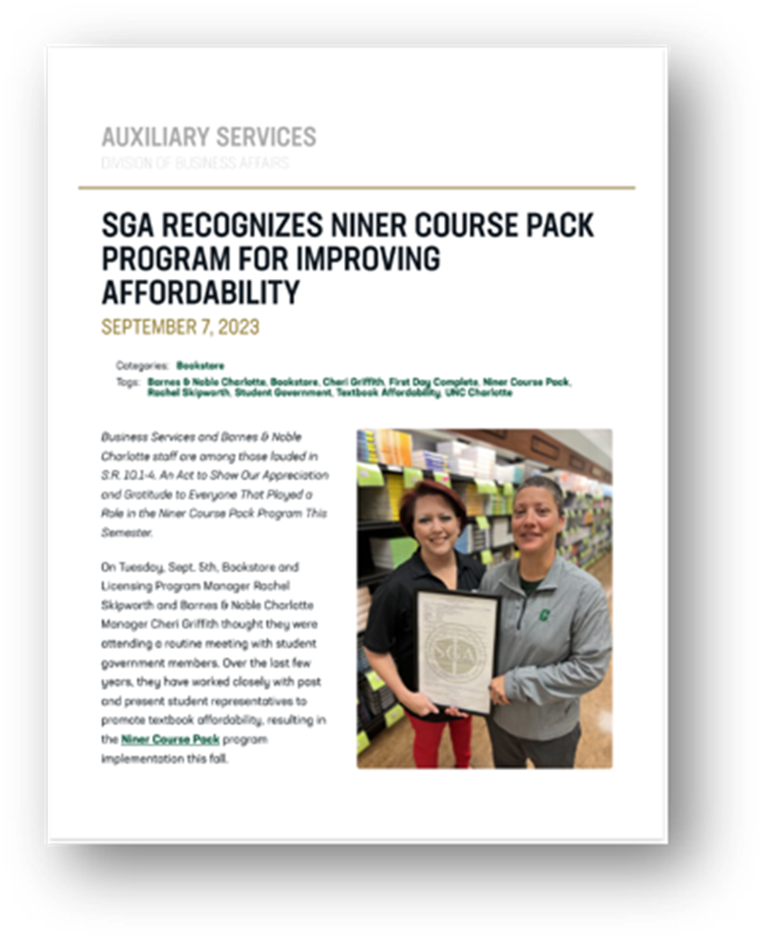
NINER COURSE PACK IMPROVES STUDENT EXPERIENCES
83%
80%
84%
of students said that the program saves them time in shopping for course materials.
of students found it convenient to have their course materials bundled as a part of Niner Course Pack.
of students said they would likely
participate in the program in the
future.
Source: First Day® Complete Student Success Survey – BNC Insights™, Spring 2024
Notes:
A recent survey conducted by our BNC Insights research team, students reported that Niner Course Pack leads to better experiences for your students. The program increases convenience, access, and affordability by saving students time and money in selecting their course materials.

Slide 11
NCP TESTIMONIALS
“This course pack is just so convenient, and it makes the beginning of the year seem much less stressful.”
“It's a very easy process and you get everything you need in one purchase.”
“it was so much cheaper and easier than buying my own materials.”
Notes:
These are just a few examples of student testimonials from your students praising our Niner Course Pack program.

Slide 12
NINER COURSE PACK:
IMPACT REPORT
Notes:
We’ve compiled an impact report to summarize the savings and other benefits your students and faculty have experienced with our program.

Slide 13
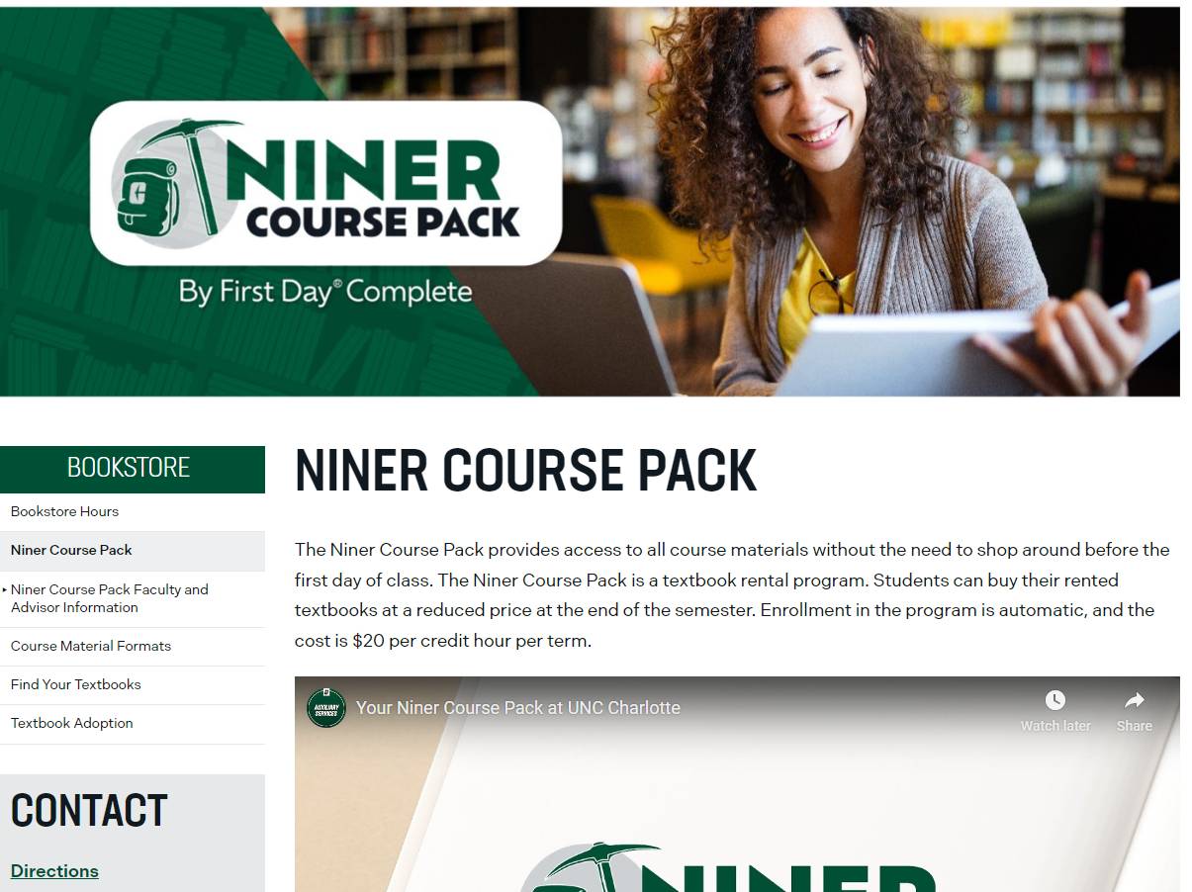


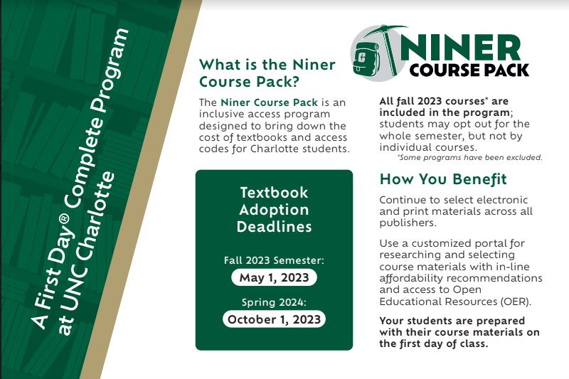
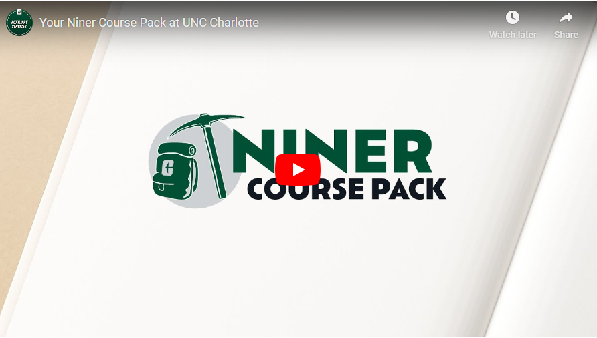
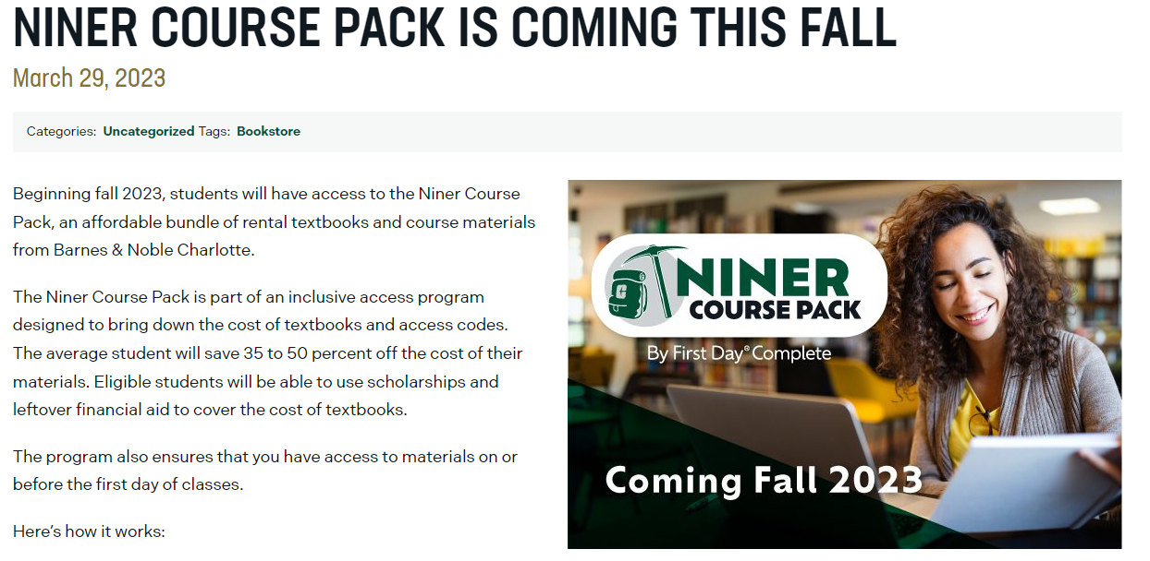
ROBUST MARKETING TOOLKIT TO DRIVE AWARENESS AND ENGAGEMENT
Web Banners
Program Landing Page
Social Media Posts
Marketing Collateral,
Presentations and more
School Video
School News

Slide 14
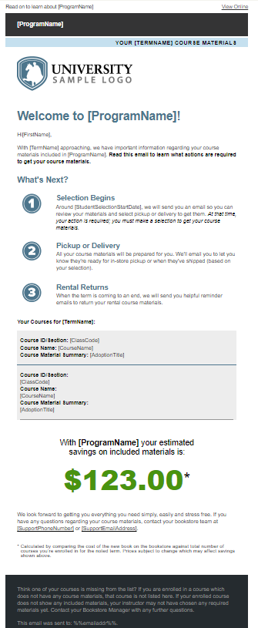
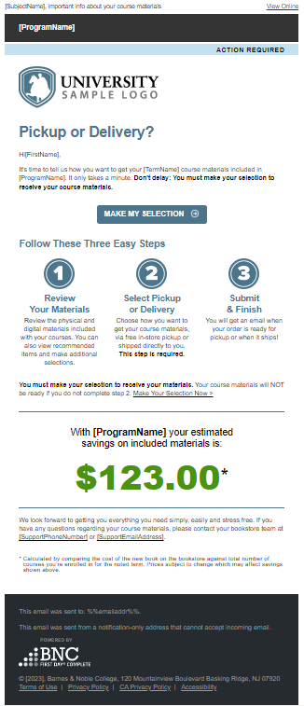
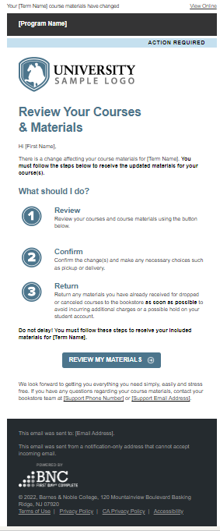
ROBUST MARKETING TOOLKIT TO DRIVE AWARENESS AND ENGAGEMENT
Welcome Email 35 days before term starts
Selection Email 30 days before term starts
Course Change

Slide 15

Fall 2023 - Spring 2024 Review
Niner Course Pack
Niner Course Pack has had a positive impact on student success by ensuring students have access to their course materials It has helped alleviate affordability concerns and equip students with the tools and resources they need to succeed.
The University of North Carolina at Charlotte Students Saved
$3,285,929
An average of 40% on course materials
IMPACT ON STUDENT OUTCOMES†
83% | 67% | 84%
said the program saved them time in shopping for course materials because they are all in one place | said with this program, they were better prepared for the academic term | said they were likely to participate in the program in the future
80% | 65% | 73%
Found it convenient to have their course materials bundled and delivered through the program | felt the program provided them with more affordable course materials | said they were likely to recommend the program to other students
†FDC Student Term Start Survey March 2024
Notes:
References:
*This methodology takes every course, determines the retail for all included materials for that course, uses the credit hours for each course multiplied by the credit hour charge to determine the savings per course by the number of students opt-ed into the program.

Slide 16
NINER COURSE PACK:
FALL 2024 DASHBOARD

Slide 17
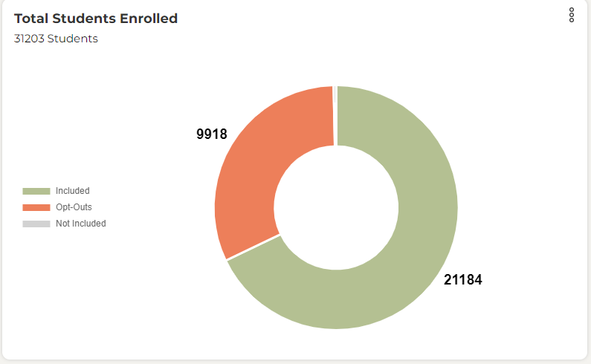
Notes:
102 Students Not Included in the NCP.

Slide 18
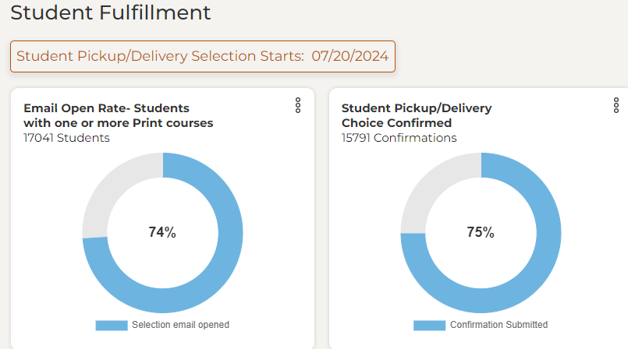

Slide 19
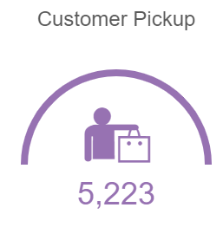
ORDERS NOT PICKED UP AS OF 9/12/24
Students are emailed as soon as their order is ready for pickup. Also, we send an email to students who orders are 30 days or older. Then we follow up with another email with a final pick update.

Slide 20
NINER COURSE PACK:
SPRING 2025 DASHBOARD

Slide 21
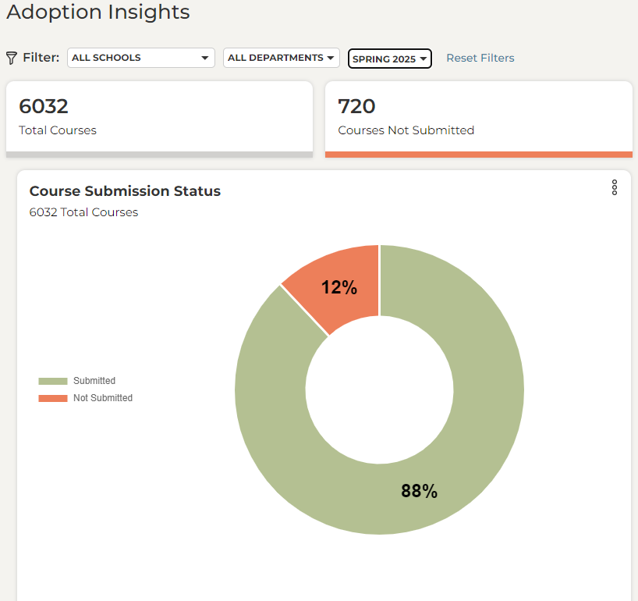
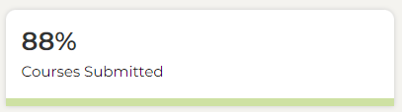
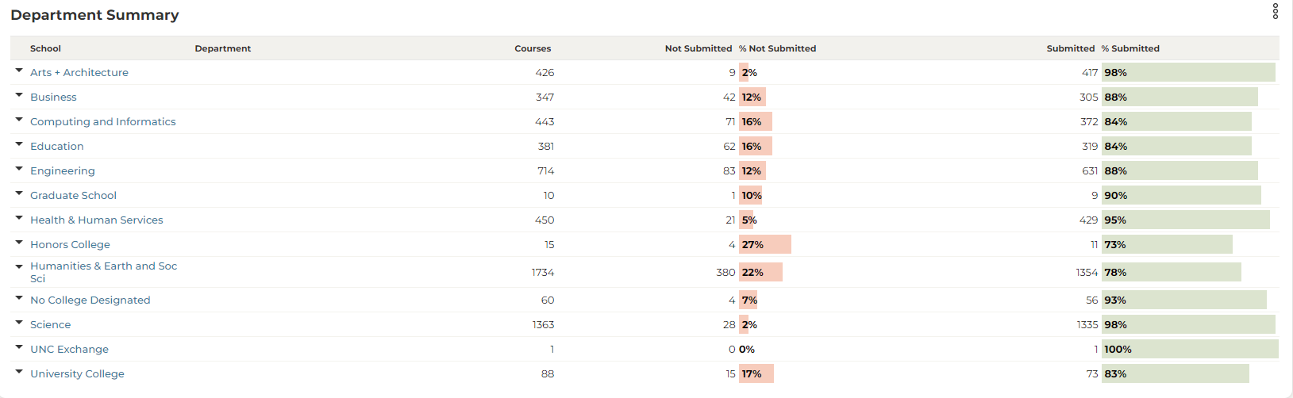

Slide 22
Questions/
Suggestions?
aux.charlotte.edu/bookstore

