Slide 1
NEW ACADEMIC LEADERS

Slide 2
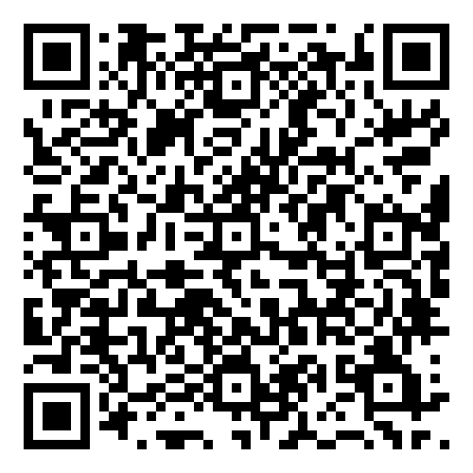
2024-2025 SEARCHES

