Slide 1

General Fund Operating
Budget Update FY22
Ken Smith,
AVC of Budgets

Slide 2

Topics
Sources of Funds
Selective Comparative Financial Data
General Funds Budget

Slide 3
SOURCES OF FUNDS
Fiscal Year-End, June 30 2021
Capital Funds
$12.5M
State Appropriated Capital Funds
Self-Liquidating Funds (from ITF)
Carry-forward funds (from GF)
Gifts / Donors
Endowment
$298.9M
Foundation
Athletic Foundation
The University Endowment
General Fund
$454.9M
Tuition, $167.3M
State Appropriations, $255.4M
Fees
Sales and Services
These funds are used to operate the university (hire personnel, educate students, provide utilities to buildings, protect the campus, etc.)
Institution Trust Funds
$304.2M
Unrestricted Endowment Funds
Contracts & Grants (Research)
Gifts
Student Fees
Education & Tech
Campus Security
Debt Servicing
Student Activities
Health Services
Auxiliaries
Dining
Housing & Residence Life
Parking
Special
Agency Funds
Athletics
These funds are also used to operate the university but any unused cash can roll into next fiscal year

Slide 4
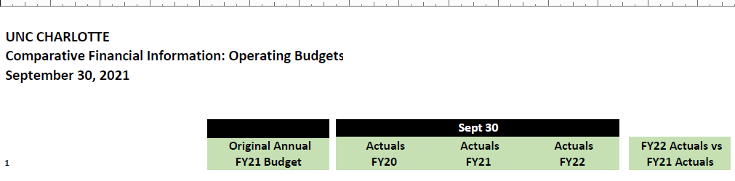
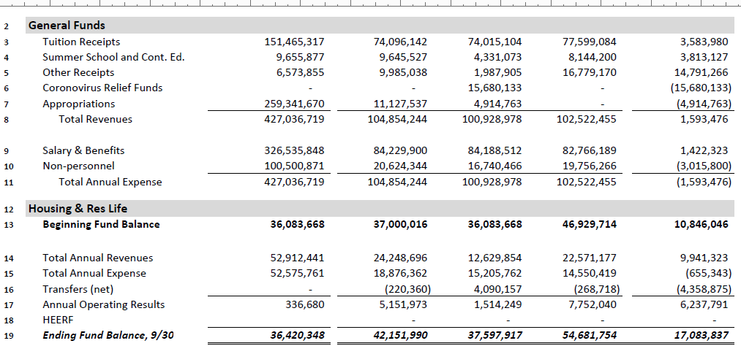
Comparative Financial Information

Slide 5
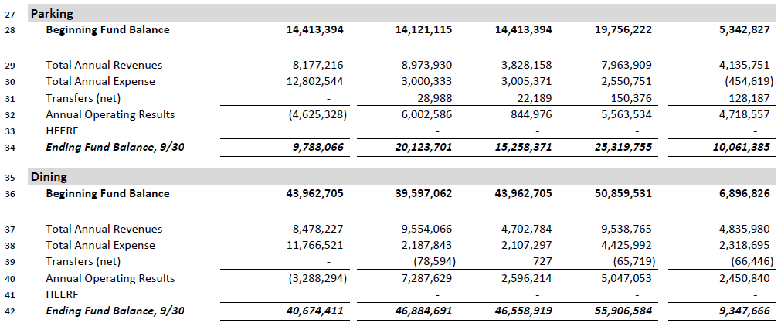
Comparative Financial Information

Slide 6
General Fund Expense Budget
($427.4MM)

Slide 7
New General Funds
Continuation Budget
Expansion Budget
Legislative Priorities

Slide 8
General Fund Operating
Budget Update FY22
Ken Smith,
AVC of Budgets

