Slide 1

Innovation & Entrepreneurship at UNC Charlotte
Faculty Council 11/17/2016
Paul Wetenhall | paul.wetenhall@ventureprise.org

Slide 2

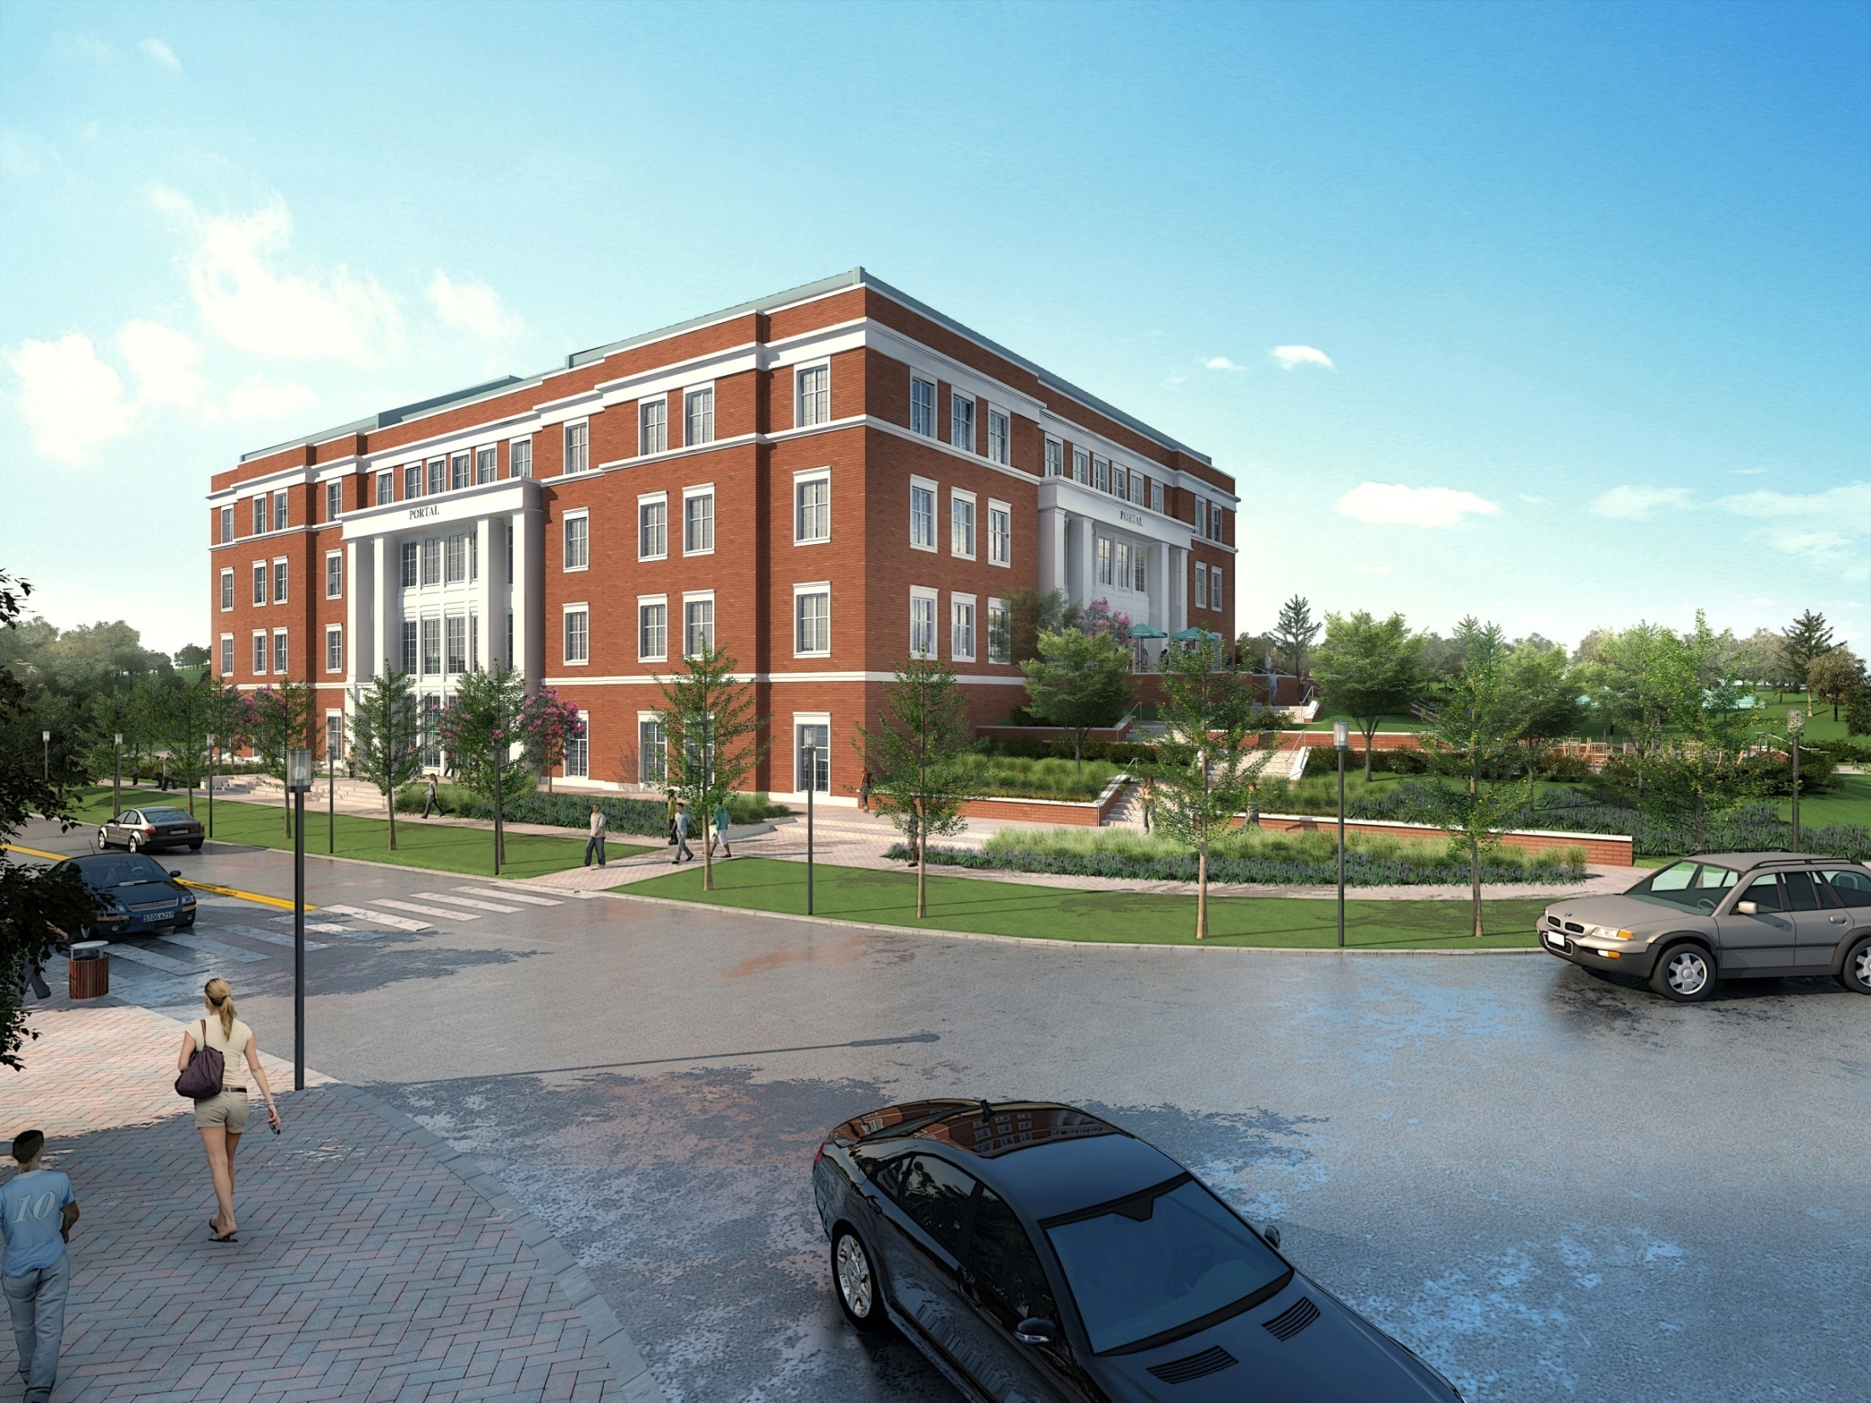
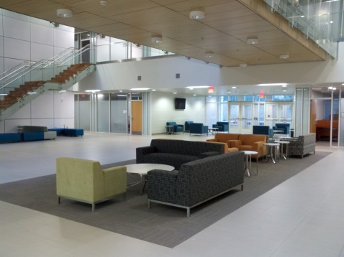
Ventureprise
Venture Development Organization
  UNCC Research & Economic Development
  Non-profit with community & university board
Focus on university innovation and entrepreneurship
  Transformative entrepreneurship will change student lives and support accelerated UNCC research growth
  Strong UNCC entrepreneurship will support
  Charlotte community economic opportunity
  Experiential & inter-disciplinary
Resources
  PORTAL university-industry collaboration
  NSF National Innovation Network
  Paul Wetenhall, Devin Collins, Carolyn Smith
  (PORTAL #252, X70900)

Slide 3
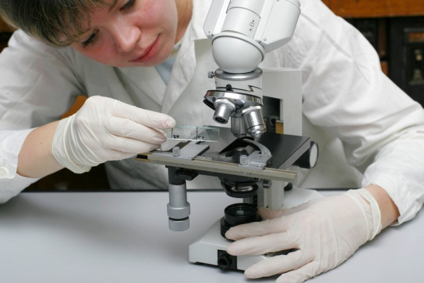

Faculty & Researchers
Ventureprise can help
  Expand access to funding
  Improve opportunity to commercialize research
  Support innovation-driven startups
NSF I-Corps Site
  UNC Charlotte only Site in NC or SC
  National Innovation Network of 51 universities
  Purpose: accelerate commercialization
  Evidence-based entrepreneurship
30 teams (student, faculty, mentor) annually
  3 cohorts of 8-week customer discovery programs
  Up to $3000 funding and NSF lineage for faculty and students
Positive outcomes lead to funding
  I-Corps National $50K, NSF AIR-TT $200K, SBIR/STTR $500K+
  Example: Video Collaboratory team of computing and dance

Slide 4
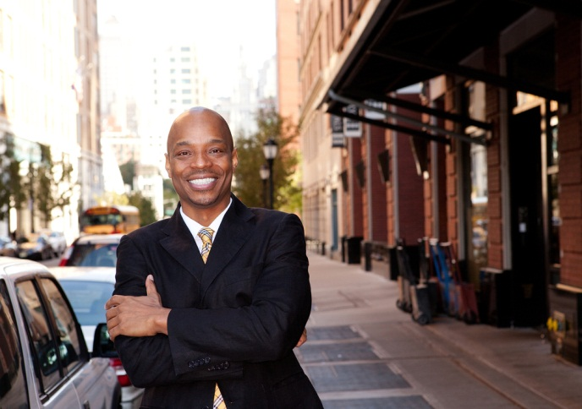

Students
Experiential entrepreneurship opportunities
I-Corps team participation
  Typically, graduate student
  Communication undergrad pilot program
UNC system social entrepreneurship competition
  Spring semester
Student business incubator in PORTAL
  Pursue business idea

Slide 5




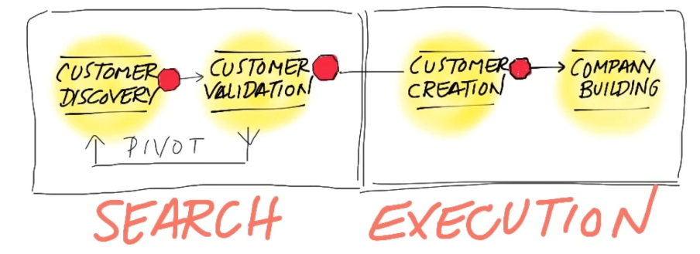


Regional Engagement
Ventureprise Launch
Data & Policy Support
Charlotte Entrepreneur Growth Report
For Students
Core Expertise
For Faculty & Researchers
Experiential Programs to be defined
49 Innovators
[Innovation pipeline]
I-Corps Entrepreneur Lead [Fall, Spring, Summer]
I-Corps cohorts & funding [Fall, Spring, Summer]
UNC Social Entrepreneur Conf. & other events
49er Launchpad
[Post I-Corps]
50 Universities
National Innovation Network
Commercialization
New Venture Creation
PORTAL office rental
ongoing incubation
Mentor Council
Community & UNCC Alumni support I-Corps, 49er Foundry, Fast Start
Collaboration

Slide 6
Topic | Contact
NSF I-Corps 49er Foundry Charlotte Venture Challenge | Devin Collins devin.collins@uncc.edu X78058
Ventureprise | Paul Wetenhall paul.wetenhall@ventureprise.org X78057

