Slide 1

New Student Convocation
Cathy Blat
Faculty Council
January 15, 2015

Slide 2
Graduation Initiative
How do we help students make the transition into the University?
What should be communicated, by whom, and when?
Transition & Engagement
Curriculum
Policy
Communication

Slide 3
New Student Convocation
Formal assembly of University faculty, staff and new students
Serves as a bookend to Commencement and creates a visual of graduation
Convocation is the one time that new students will be together in one place at the same time hearing a common, unified message
Notes:
The University does not have a formal academically focused ceremony to transition new students into their new environment.
87% UNC and 76% peer institutions hold a New Student Convocation.

Slide 4
New Student Convocation
Goals
Welcome, recognize, celebrate, and introduce new students to the University community
Introduce academic expectations (Prospect for Success outcomes)
Build community by establishing a ritual and creating a meaningful rite of passage
Notes:
Goals:
The goals of the New Student Convocation at UNC Charlotte are to:
Welcome new students and validate their sense of belonging.
Communicate the institution’s values, expectations and commitment to student success.
Build community by establishing rituals which promote student identification with UNC Charlotte and create a meaningful rite of passage to incorporate students into the UNC Charlotte community.
Crystallize the legacy of the University. Students will have a chance to learn about the history of UNC Charlotte and receive the challenge to continue its mission.

Slide 5
New Student Convocation
Proposed Program
Time | Activity | Lead/Presenter
11:00 | Faculty Procession | Faculty
11:05 | Welcome to Incoming Class | Provost Lorden
11:10 | Institution history: Bonnie Cone Legacy | Mike Wilson, Board of Trustees & alumnus
11:25 | University vision/mission; Expectations (PfS Outcomes) | Chancellor Dubois
11:35 | Keynote address by a Faculty member | Bank of America or Cone teaching award recipient/Distinguished faculty
11:50 | Honor Code/Noble Niner | Cameron Hurst, Co-creator of Noble Niner & alumna/ Student Body President
12:00 | Alma Mater | Inaugural performance of the Pride of Niner Nation Marching Band
12:15 | Procession out | Faculty

Slide 6
New Student Convocation

Slide 7
New Student Convocation
Proposed date: Monday, August 24th, 2015
Location: Dale Halton Arena
New Student Convocation can be followed by:
  College/Department receptions
  Lab tours/demonstrations
  Capstone projects showcase
  Advising
  Experiential Learning opportunities
  Alumni/Professional Organizations network activities

Slide 8
New Student Convocation
Planning Committee
Dee Baldwin (CHHS)
Catherine Blat (UCAE)
Allan Blattner (HRL)
Kim Buch (CLAS)
Liz Fitzgerald (UCOL)
Nancy Gutierrez (CLAS)
Eddy Souffrant (CLAS)
Dennis Wiese (DSO)
Leslie Zenk (Office of the Provost)

Slide 9
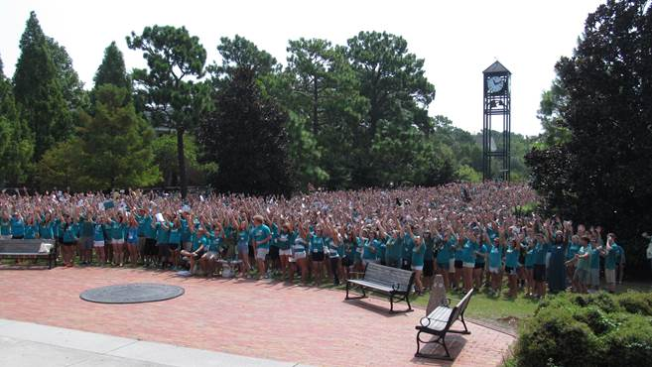
New Student Convocation
http://gigapan.com/gigapans/162247

