Slide 1

State of Information Technology
Presentation for Faculty Council
November 14, 2013
Mike Carlin
Vice Chancellor for IT and CIO

Slide 2
Completed Projects July 2013 to Present
HR Data Mart Enhancement
Decommission Old Enterprise Storage
Graduate Academic Petition
Grade Change Process
Emergency Alerts System
Treasury Services Financial Statements Development
49er Mart Journal Voucher Entry for Internal Vendors

Slide 3
Completed Projects July 2013 to Present
Payment Card Industry (PCI) Migration to New Network
Moodle 2.0 Upgrade Migration to New Servers
VMware Infrastructure Expansion
Deck J RUP 4
Centralized Apple Device Management
DNS/DHCP Replacement

Slide 4
Completed Projects July 2013 to Present
Benefit Eligibility & Deduction Vendor Change
Banner Upgrades
WiFi Expansion

Slide 5
Quick Facts
Total Tickets Submitted and Total Resolved by ITS
July 2013 to Present

Slide 6
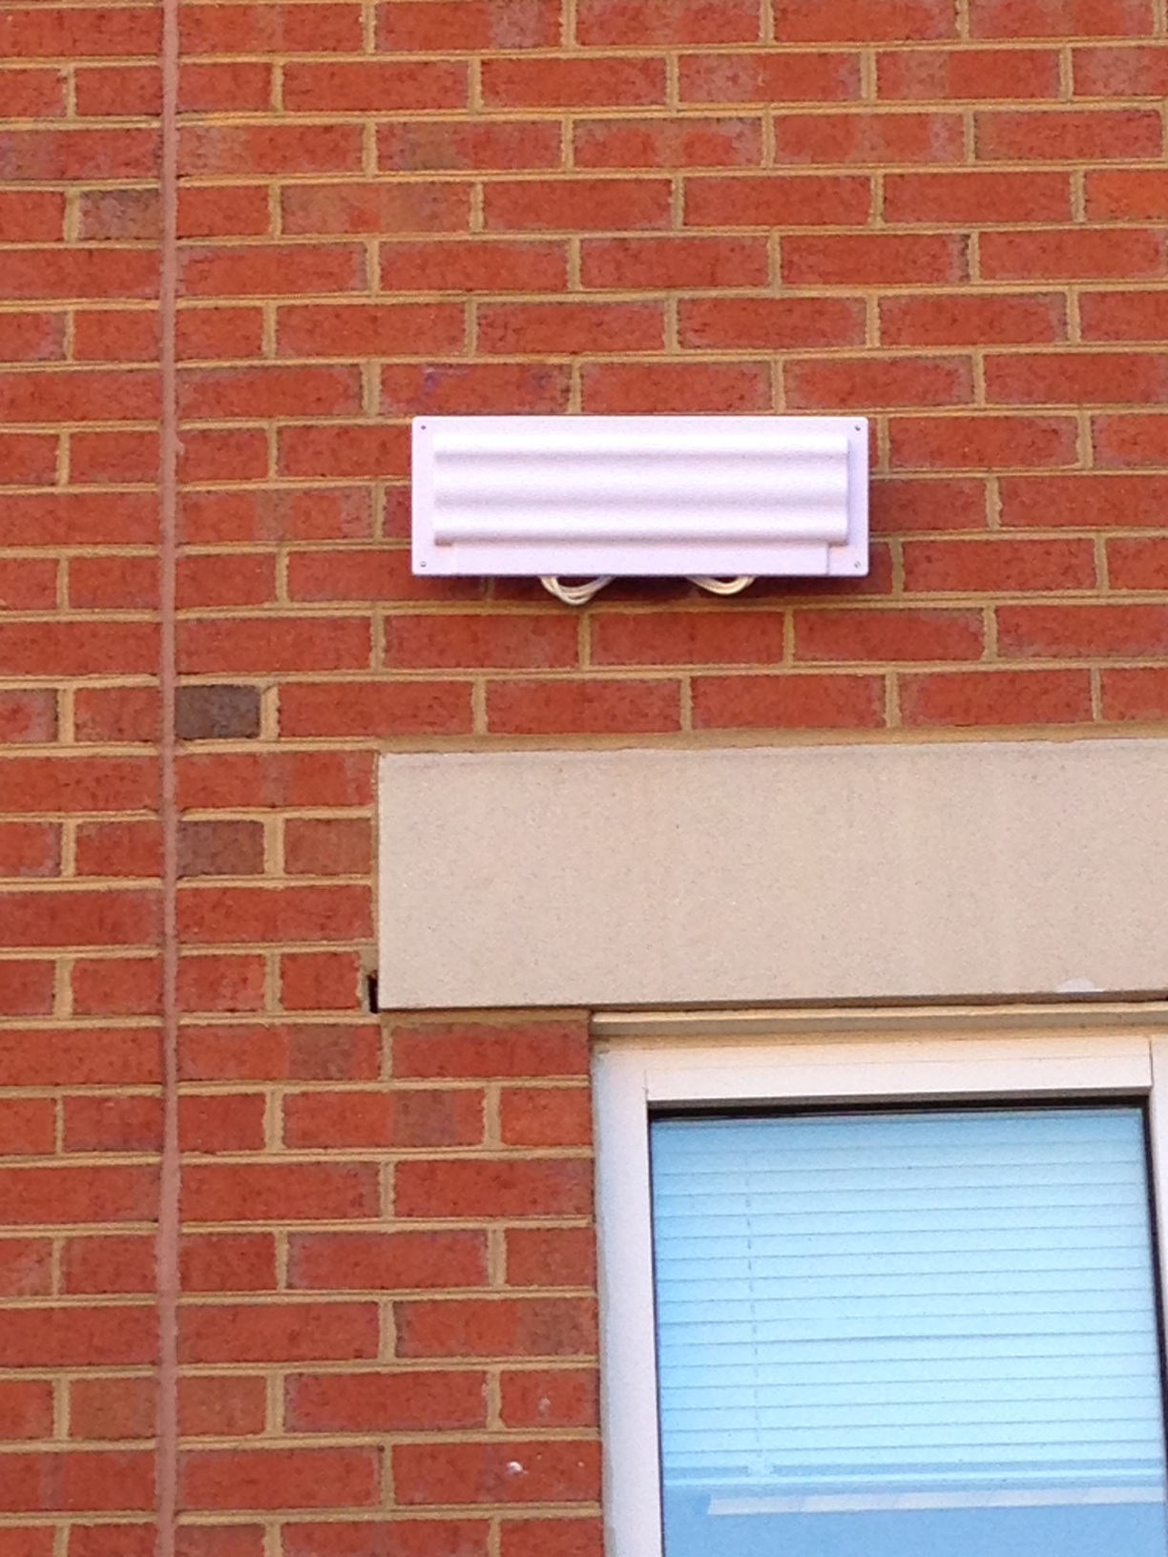
Highlighted Projects
Campus Wireless
Increased Wireless Access Points (WAP)
949 Existing WAPs
353 WAPs Upgraded
601 New Installs
Total 1,550 WAPs Campus-Wide
Completed in 6 Months

Slide 7
Highlighted Projects
Year

Slide 8
Areas of Focus
Consistent and Reliable Delivery of All Services
  Continued Improvement of Customer Service
  Building Trust and Confidence With Our Customers
Strengthen Disaster Recovery Capabilities
  Enhance System Redundancy at MCNC (Research Triangle) Data Center
  Extend Non-Banner Service Redundancy

Slide 9
Areas of Focus
Continued Virtualization of Physical Servers
  Improves Disaster Recovery
  Greater Efficiency & Fewer Wasted Computing Resources
Migrate and Upgrade Aging Systems
  Dozens of Systems Running Old and Soon to Be Unsupported Operating Systems
  Many Physical Servers Out of Warranty

Slide 10
Areas of Focus
Training and Awareness
  Improve Documentation and Support for Services and Applications
  Enhance Communications and Transparency to the Campus Community
IT Master Plan
  Total of 9 Sessions Over the Last Two Months
  Completing Last Three Work Sessions This Week
  Developed Draft Initiatives From Each Session
  Draft Report in Early Spring

Slide 11
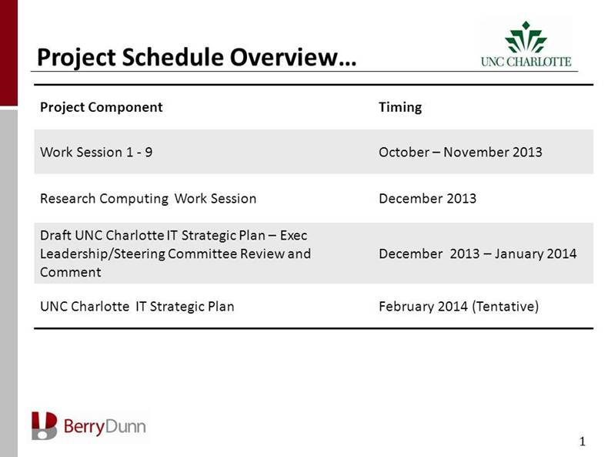
ITMP Schedule

Slide 12
Areas of Focus
Continued Improvements to Security
  Assess Effectiveness of Current Protections
  Ensure Appropriate Balance Between Security and Ease of Use
  Provide Greater Transparency to Campus Community

Slide 13
Current ITS Sponsored Projects
Security and Compliance
UNC Charlotte’s Adoption of ISO 27002
  Step 1 Policy
  Step 2 Standard
  Step 3 Guideline(s)
  Step 4 Form(s)
Beginning With Data Policy and Data Use Guidelines
Clear and Concise Definitions
Easily Understood Data Levels (0 to 3)
Audits

Slide 14
Current ITS Sponsored Projects
Identity Management and Single Sign On (SSO)
Shibboleth and InCommon Federation
Develop and Identify Campus Rules and Convert into Actual Workflows with IDM Tool
Benefits
Complete End to End Account Life Cycle Management
Guest & Sponsored Accounts
Shared Resource Access Between Institutions
Federated Authentication with Member Institutions

Slide 15
Transformative Project
Virtual Lab Desktop Pilot Phase II Spring 2014
  Current Participants
    College of Health and Human Services
    College of Business
    College of Computing and Informatics
  Benefits
    Provides Windows Lab Image Via Web Browser
    Any Time Any Where Access – No Longer Bound to the Lab
    Utilizes New Enhanced Campus WiFi
    Works on Tablets, iPads, Laptops
    Turn Any Classroom Into A Computer Lab

Slide 16
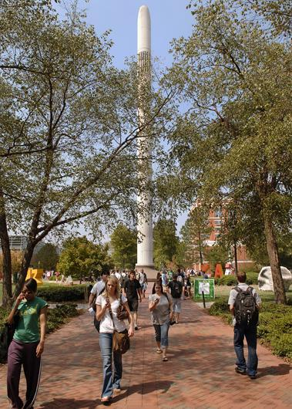
Questions?

