Slide 1
FIRST DAY® SOLUTIONS AT
UNC CHARLOTTE
Notes:
Photo Credit: Shutterstock

Slide 2
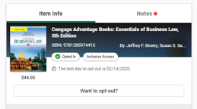
Current Model - First Day® by Course
First Day® is a course material delivery model that supports UNC Charlotte’s diverse student population by ensuring students have access to their course materials before the first day of class.
How it Works
FACULTY CHOOSE THEIR
COURSE MATERIALS
STUDENTS ACCESS
COURSE MATERIALS
directly in UNC Charlotte Canvas
DISCOUNTED COURSE MATERIALS
applied to the student account
Notes:
First Day is our inclusive access program.
Launched in 2019 in New Brunswick as a pilot with 7 courses, 2,814 student enrollment
Added Newark in Spring 2021
Added Camden in Fall 2021
Faculty included want to participate. They retain complete academic freedom in terms of the course materials they want to utilize in their class- we discount the materials in partnership with the publisher- and deliver it within Canvas prior to the first day of classes
Students do not have to search for what they need and, importantly, it is offered at the lowest possible price- lower than publisher direct.
Faculty can begin teaching on the first day of class– no longer have to deal with students who can’t find the material, decide not to purchase it, or have access issues with codes/emails/etc.
Additional benefits detailed on next slide

Slide 3
First Day® Growth at UNC Charlotte
6,416 students
In 2021-2022 the First Day® program saved UNC Charlotte students
$371,976
99 sections
1,404 students
22 courses
11 sections
2 courses

Slide 4
COURSE | RETAIL COST | FIRST DAY COST | SAVINGS
ACCT 2121 | $181.43 | $53.63 | $127.80
ECON 2101 | $160.50 | $99.08 | $61.42
FINN 3120 | $195.00 | $119.80 | $75.20
PHYS 2101 | $165.79 | $80.43 | $85.60
SPAN 1201 | $225.00 | $79.26 | $145.74
*Based on F22 pricing

Slide 5
BUILDING ON SUCCESS AT UNC CHARLOTTE
FIRST DAY® COMPLETE
A proven solution that provides access, affordability, and convenience for ALL students
STUDENTS
AUTOMATICALLY
receive all their books and access to electronic materials on or before the first day of class
MATERIALS ARE APPLIED
as a course charge to the student account
SIGNIFICANT STRESS REDUCTION
& COST SAVINGS
for students versus the traditional model
Notes:
First Day Complete helps to remove barriers for ALL students.
First Day Complete is expanding the First Day by course program to all students.
ALL course materials would be provided prior to the first day of class- either digital and print
One per credit hour price can be developed and billed to students through a course charge or added into tuition
ALL students, and parents, no longer have to worry about what they need, where to find it, how much does it cost? It's all provided!

Slide 6
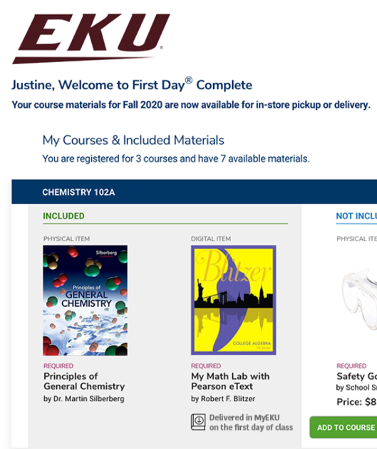
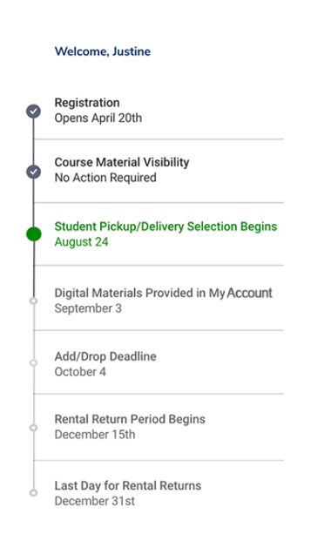
PERSONALIZED STUDENT EXPERIENCE
STEP 1 |
REGISTER FOR CLASS
VERIFY MATERIALS
STEP 2 |
STEP 3 |
SELECT FULFILLMENT METHODS
STEP 4 |
RECEIVE
MATERIALS
END OF TERM:
RETURN MATERIALS
STEP 5 |
Demo: https://invis.io/CH1302CERYJE
Notes:
Review slide

Slide 7
IMPROVING EQUITABLE ACCESS, CONVENIENCE & AFFORDABILITY AT
UNC CHARLOTTE
Full Time Student would now only spend
$300
(Based on 15 credit hours)
* UNC Charlotte currently recommends allocating
$500
for books for an
academic term
First Day® Complete Pricing per credit hour
$20
*https://admissions.charlotte.edu/afford/cost-attendance
Notes:
We have already reviewed equitable access and convenience and how that benefits student outcomes and with affordability – pricing is customized for your campus.

Slide 8
FIRST DAY® COMPLETE
FOR FACULTY
Faculty maintain full academic freedom
Includes electronic and print materials
Students are prepared on the first day of class
FOR STUDENTS
Students have access to course materials by the first day of class
Highly personalized, concierge service
Students save on average between 35%-50% on the cost of course materials across their academic journey
FOR THE INSTITUTION
Supports student success
A study shows improved retention and completion rates
Marketable to prospective and current students to support enrollment

Slide 9
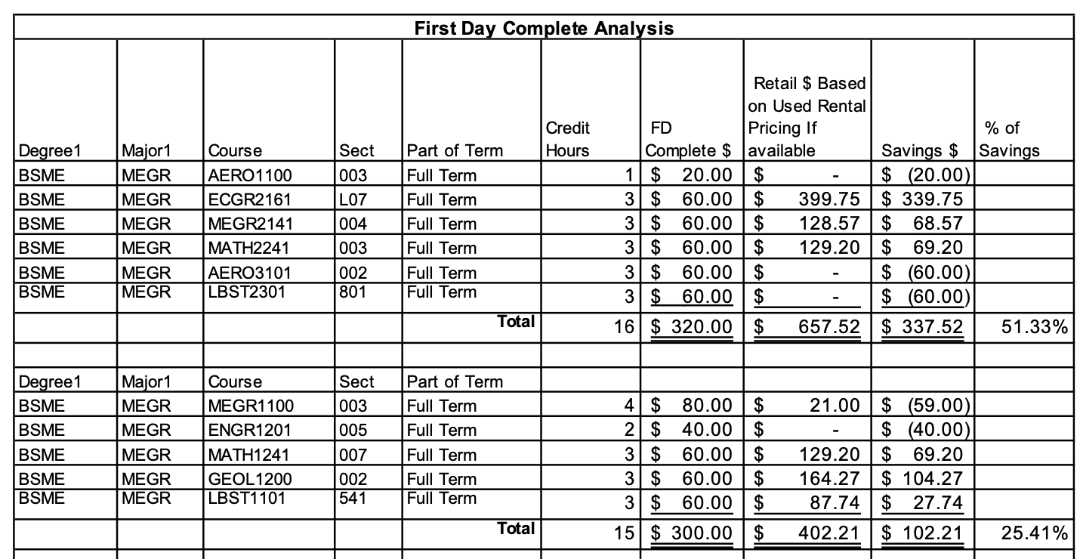
Textbook Comparison

Slide 10
FIRST DAY® COMPLETE PROGRAMS IN NORTH CAROLINA

Slide 11
OPTIMAL TIMELINE FOR
FALL 2023 LAUNCH
OCT-NOV
2022
JANUARY - MARCH 2023
MARCH –
MAY 2023
JUNE –
JULY 2023
AUGUST – SEPT 2023
FALL TERM
2023
DECISION TO PROCEED
IMPLEMENT PROGRAM
COMMUNICATION TO STUDENTS/ FACULTY
STUDENT ORDER PACKAGING AND FULFILLMENT SELECTION
STUDENT REMINDER NOTICES AND COURSE MATERIAL PICK-UP
FIRST DAY®
COMPLETE
SUCCESSFULLY LAUNCHED
Notes:
We’ve implemented it at a lot of schools, and we know what it takes and how long you can expect the implementation process to take.
Here we mocked up what it would look like to implement by Fall 2022, and it means the decision to proceed needs to be made by the end of the year.

Slide 12
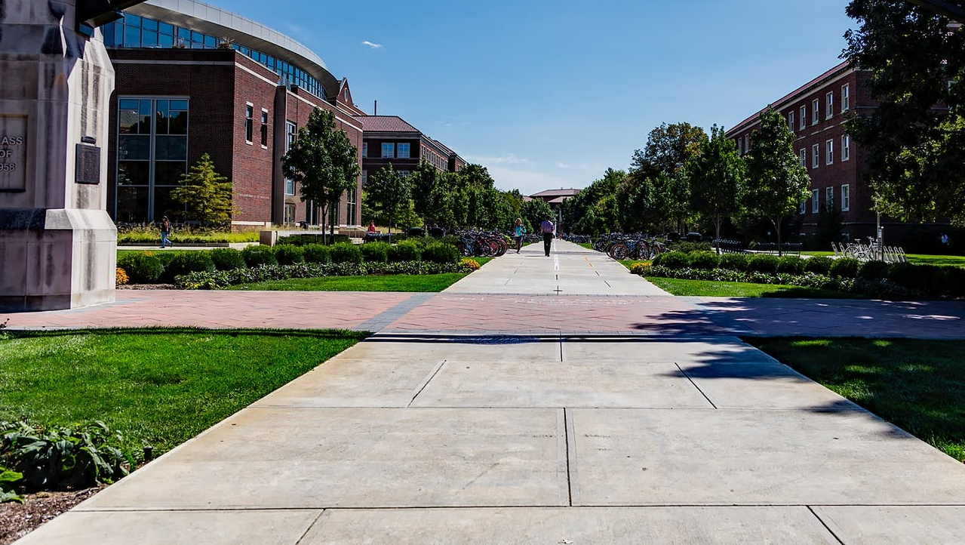
Questions?

