Slide 1

Free Expression & Constructive Dialogue Committee - Created by Provost Lordenl
    The Free Expression and Constructive Dialogue Task Force was created in 2022 by then Provost Joan Lorden, and under the direction of the Faculty Advisory Library Committee of the Faculty Council, following a report commissioned by the UNC Board of Governors related to a survey exploring free expression on college campuses throughout the UNC System. Chaired by Anne Cooper Moore, dean of Atkins Library, the task force is charged with engaging the community to develop and practice the skills of speaking freely, openly and respectfully on all topics.

Slide 2
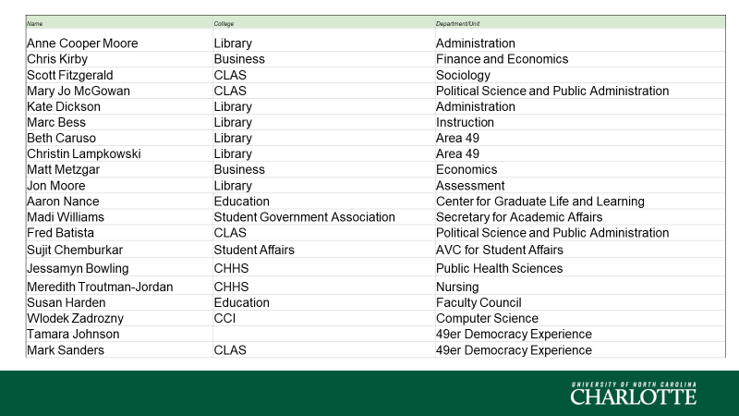
Free Expression & Constructive Dialogue Committee - Members

Slide 3
Programs
Constructive Dialogue Faculty Learning Community
Website hosted by Atkins Library with American Library Association Grant
Heterodox Academy grant - one of 23 campuses selected
Civic Discourse Student Fellows
Sanctuary Method for Social Issue Discourse
Panel Discussions
Discussion on Free Expression with Vice Chancellor of Institutional Integrity and General Counsel Jesh Humphrey, Associate Vice Chancellor for Student Affairs Sujit Chemburkar, along with Mary Griffin from the Foundation for Individual Rights and Expression (FIRE), and Susan Harden as moderator, 4-5:30 p.m.,
Campus Panel and Forum on Institutional Neutrality with Mark McNeilly, UNC-CH; Steven McGuire, ACTA; Rosemarie Monge, James Madison Program Visiting Fellow; Jesh Humphrey; and Susan Harden as moderator on April 21 from 10-11:30 a.m. in the Halton Reading Room Atkins Library.

Slide 4
Resolution
    The UNC Charlotte Faculty Council now resolves:
    Public expression on matters of local, regional, national, and international importance is a core component of the jobs of many members of the faculty and must not be suppressed.
    Faculty members should be entitled to indicate their university affiliation in all expression related to their research, teaching, and service, so long as they do not indicate that they speak for the University as an institution.
    The University and its leaders must actively and publicly advocate for and defend the free speech rights of faculty members, staff, and students for all speech protected by the First Amendment.
    In support of this mission, the rights of the library to collect and disseminate any legally available information must also be upheld.
    The Faculty endorses the Report of the Committee on Freedom of Expression produced by the University of Chicago (link added by the Faculty Executive Committee) to promote and protect free speech on campus. Submitted by UNC Charlotte’s Free Expression Task Force Spring 2023 *Note (requested by the Faculty Executive Committee) The following institutions or faculty bodies have adopted or endorsed the Chicago Statement or a substantially similar statement. The Chicago Statement is a free speech policy statement. The UNC System adopted a Free Speech Policy in 2017 informed by the Chicago Statement.

Slide 5
Resolution - Next Step
    Special Called Meeting of the Faculty Council to Discuss and Vote on the Resolution
    Expect a vote on a similar, if not identical, resolution at the April 27 Board of Trustees Meeting
    Thursday April 6, 2023 1 p.m. Fretwell 100
    Please share with units, be prepared to discuss and vote
    Send an alternate

