Slide 1
Concussions:
From the Field to the Classroom
Robert Jones, M.D.
Medical Director
UNC Charlotte Student Health Center

Slide 2
Objectives
Identify common signs and symptoms of concussion
Become familiar with the potential impact of concussion on cognitive activity
Become familiar with the possible accommodations necessary for students to return to the classroom

Slide 3
My Child Doesn’t Have a Brain Injury, He Only Has a Concussion
DeMatteo CA, et al. Pediatrics. 2010;125(2):327-34.

Slide 4
Definition
A complex pathophysiologic process affecting the brain, induced by biomechanical forces

Slide 5
Definition (cont)
May be caused by either a direct blow to the head, face, neck, or body with an “impulsive” force transmitted to the head

Slide 6
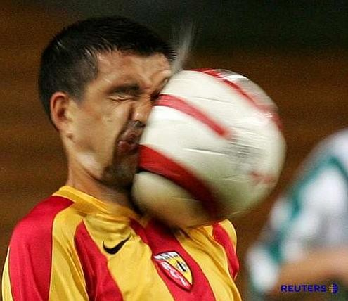

Slide 7
Definition (cont)
Rapid onset of short-lived impairment of neurological function that resolves spontaneously
Mostly a functional disturbance rather than a structural injury

Slide 8
Definition (cont)
Graded set of clinical symptoms that may or may not involve loss of consciousness.
Resolution of the clinical cognitive symptoms typically follow a sequential course.

Slide 9
Relative Terms
Mild Traumatic Brain Injury (mTBI)
Concussion
Subgroup of TBI
Commotio Cerebri
European nomenclature

Slide 10
Background
CDC estimates 1.6 to 3.8 million concussions in sports/recreational activities annually
Concussions account for 5% to 9% of all sports related injuries
NCAA ISS shows concussion rates doubled from 1988 to 2004
(per 1000 athlete exposures)

Slide 11
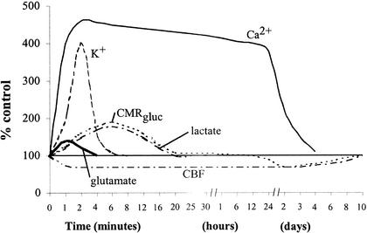
Concussion Pathophysiology

Slide 12
Concussion Signs and Symptoms
Thinking/Remembering | Physical | Emotional/Mood | Sleep
Difficulty thinking clearly Feeling slowed down Difficulty concentrating Difficulty remembering new information | Headache Fuzzy or blurry vision Feeling sick to your stomach/queasy Vomiting/throwing up Dizziness Balance problems Sensitivity to noise or light | Irritability- everything bothers you easily Sadness More moody Feeling nervous or worried | Sleeping more than usual Sleeping less than usual Trouble falling asleep

Slide 13
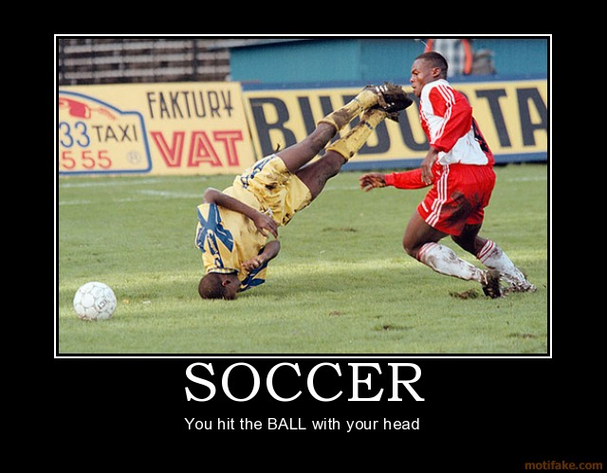
YouTube Video

Slide 14
Concussion Management
Most concussions resolve in about 7 to 10 days
Physical and cognitive rest until symptoms abate
Once symptoms resolve, begin graded progression of exertion
Upon completion of activity progression the patient can be cleared to return to play

Slide 15
What is Physical and Cognitive Rest?
Sitting/lying in an area with low stimulus- try to increase sleeping
No physical exertion
No visually stimulating activities:
Watching TV
Using Computers
Texting
Reading
Video Games
Sometimes involves missing class

Slide 16
Potential Accommodations
Brief absence from classes
Rest periods during the day
Extension of deadlines
Postponement/ Adjustment of tests

Slide 17
Potential Accommodations
Extended time on tests
Use of audiobooks, note-takers, recording lectures, oral exams
Take exams in a smaller, quiet room
May have difficulty with video presentations or group work

Slide 18
Any Questions?
Thank you for your time

