Slide 1

Faculty Council Report
Charlotte Board of Trustees
December15, 2021
Susan B. Harden, Faculty Council President

Slide 2

Guiding Questions:
How can we make decisions that enhance policies, practices, and resources that make the University a desirable place to live, learn, and work?
Does our faculty compensation system support this strategic goal?
Do investments in Faculty (and Staff) yield a high return? Are these winning investments?

Slide 3

Thesis:
UNC Charlotte faculty are high-performing and fundamental to the success of system-wide performance measures and the strategic plan. (Retention and Graduation Rates)
Increases in faculty compensation do not reflect faculty performance over the last ten years.
Multi-year and multi-source investments in personnel are needed to close the gap ensure the long-term viability and protection of past investments. Investments in closing the pay gaps are analogous to deferred maintenance.

Slide 4

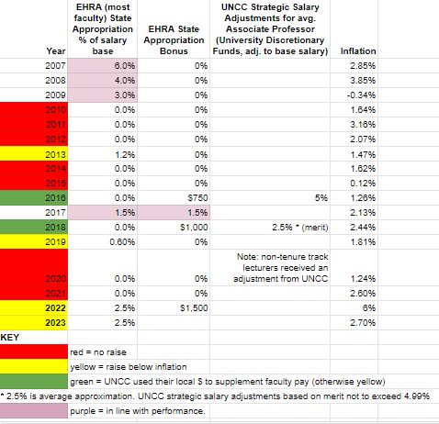
Charlotte Faculty Salary and Bonus History
Thank You for all the supportive advocacy.
Faculty are grateful.
It stopped the crisis.
Raises below inflation.
Not a compensation strategy for rewarding high performance or getting to R1.

Slide 5

What Faculty Want:
Seeking a long-term plan from UNC Charlotte leaders to improve faculty (and staff) compensation.
Something to Pay Attention to:
Salary Compression – 2nd highest faculty concern after lack of raises
Information at hand: 1) The problem is large and complex. 2) We don’t have the funds to address. 3) There is no plan to address.

