Slide 1
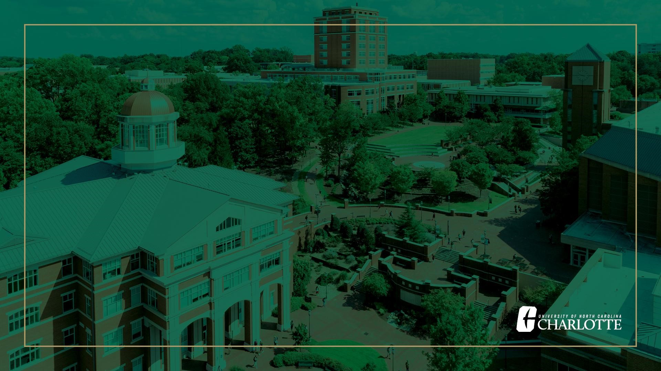
Faculty Council
Free Speech/Free Expression Update
Jesh Humphrey
Vice Chancellor for Institutional Integrity and General Counsel
September 15, 2022

Slide 2

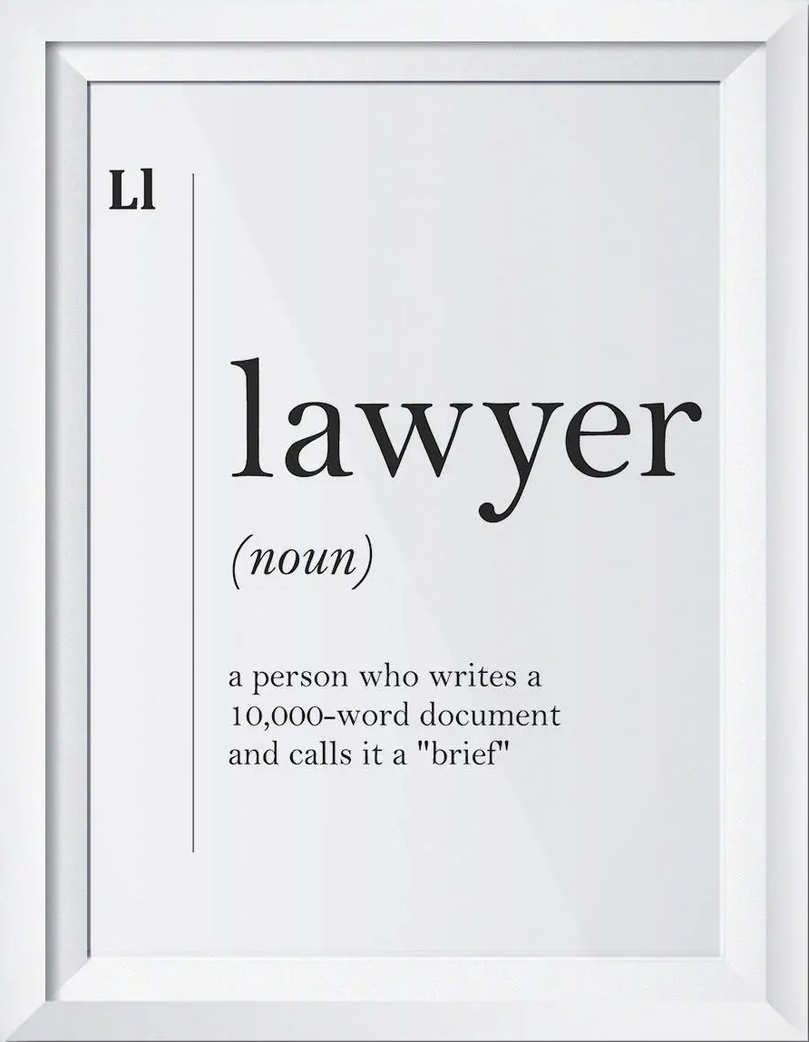
Overview of Conversation
Brief free speech/free expression legal refresher
How we’re doing
Next steps for UNC Charlotte and its Board

Slide 3
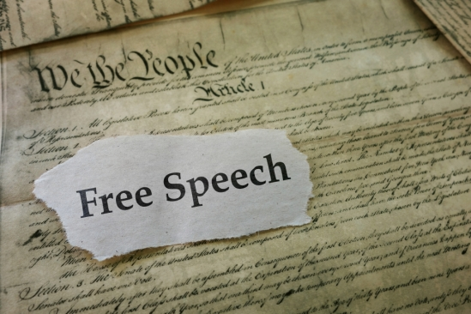
Free Speech/Expression Flyover – Sources of Law and Policy
…and UNC Charlotte
or policy!
^
First Amendment
  “Congress shall make no law . . . abridging the freedom of speech . . . ”
  The Supreme Court has called freedom of speech and expression “the matrix, the indispensable condition, of nearly every other form of freedom” that occupies a “preferred place” in our constitutional system.
    “Before the debate even starts, speech has an advantage, even against some very good reasons to limit it.”
  Why?
    Freedom of Thought
    Democracy
    History
^

Slide 4
Free Speech/Expression Flyover – Sources of Law and Policy
NCGS 116, Article 36: Campus Free Speech
  Affirms First Amendment principles
  Establishes BOG Committee on Free Expression with annual reporting requirement
  Requires free expression to be included in freshman orientation
  “It is not the proper role of any constituent institution to shield individuals from speech protected by the First Amendment, including, without limitation, ideas and opinions they find unwelcome, disagreeable, or even deeply offensive.” (Chicago Statement)
  Institutions must not take action “on public policy controversies of the day in such a way as to require students, faculty, or administrators to publicly express a given view of social policy.” (Kalven Report lite)
Section 1300.8 of The UNC Policy Manual: Policy on Free Speech and Free Expression
  Affirms and restates state law
  Prescribes disciplinary sanctions for disrupting free speech events
  Requires institutions to designate “responsible officer(s)”

Slide 5
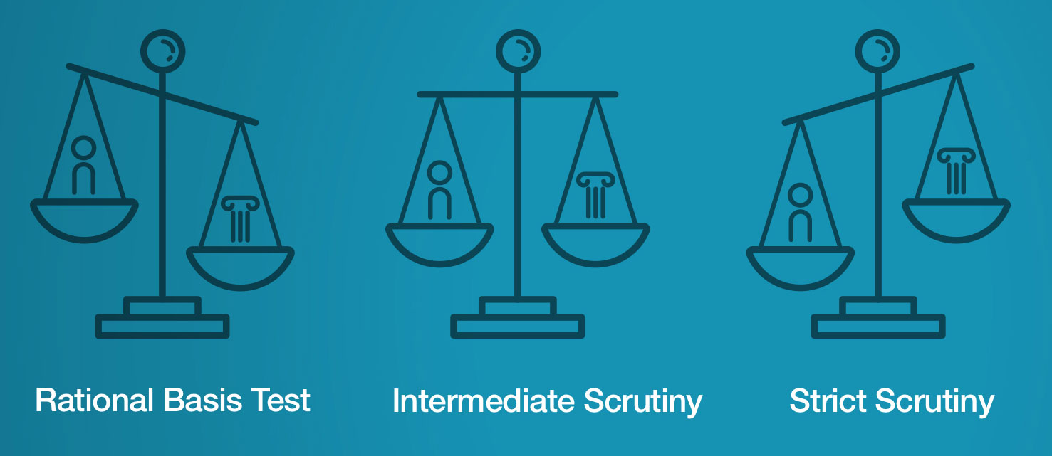
Free Speech/Expression Flyover – Basic Principles
“Freedom from” and “freedom to”
“State action” requirement
Constitutionality of UNC Charlotte’s content/viewpoint-based restrictions on protected speech subject to “strict scrutiny”
  Compelling governmental interest
  Narrowly tailored
  Least restrictive means
  “Strict in theory, fatal in fact”

Slide 6
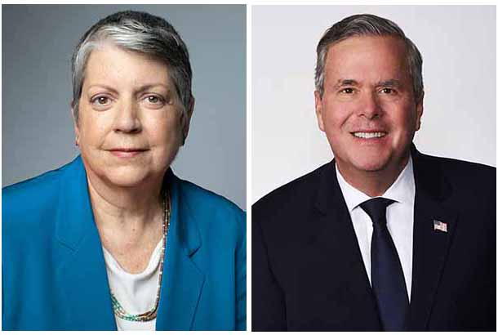
How we’re doing…
Free expression is infused into our guiding commitments
  Integrity and Respect: Ensuring the highest academic, professional, and ethical standards and a collegial culture that embraces different perspectives, civil discourse, and free expression, where all University members are treated with respect, fairness, and dignity.
FIRE “green light” speech code rating
freespeech.charlotte.edu
  <2 complaints/annually related to administrative action that implicates free speech rights, dealt with swiftly
Renewed commitment to inviting speakers representing diverse viewpoints
Regular training sessions for faculty and staff

Slide 7
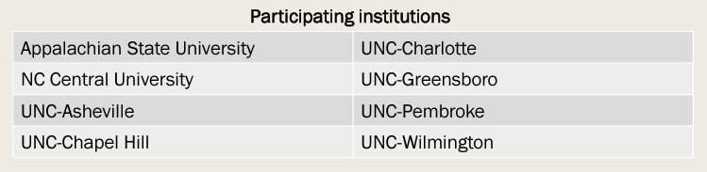
How we’re doing…
An uphill battle
  “For all the tolerance and enlightenment that modern society claims, Americans are losing hold of a fundamental right as citizens of a free country: the right to speak their minds and voice their opinions in public without fear of being shamed or shunned.”
    -New York Times Editorial Board, “America Has a Free Speech Problem,” March 18, 2022.
“Free Expression and Constructive Dialogue in the University of North Carolina System”
  Faculty-led study initiated at UNC-CH in 2019 by Dr. Timothy J. Ryan and co-PIs
  Expanded to eight UNC System constituent institutions, including UNC Charlotte, in 2022 (UNC Charlotte investigator: Dr. Mel Atkinson).

Slide 8
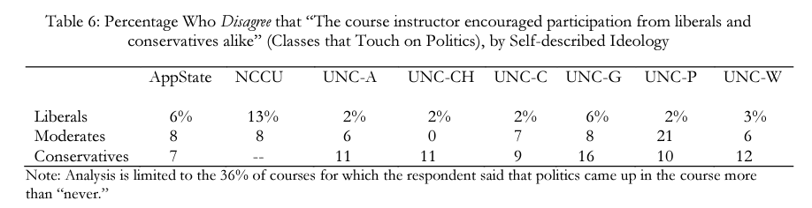
How we’re doing…
Finding 1: Faculty generally do not push political agendas.

Slide 9
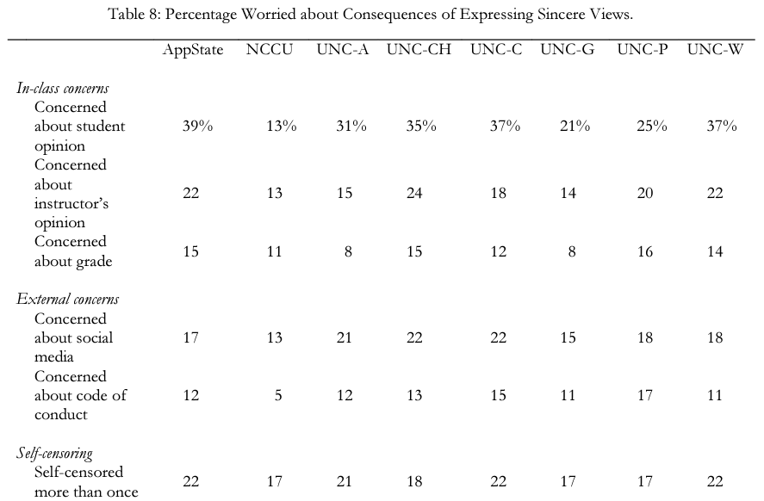
How we’re doing…
Finding 2: Campuses do not consistently achieve an atmosphere that promotes free expression.

Slide 10
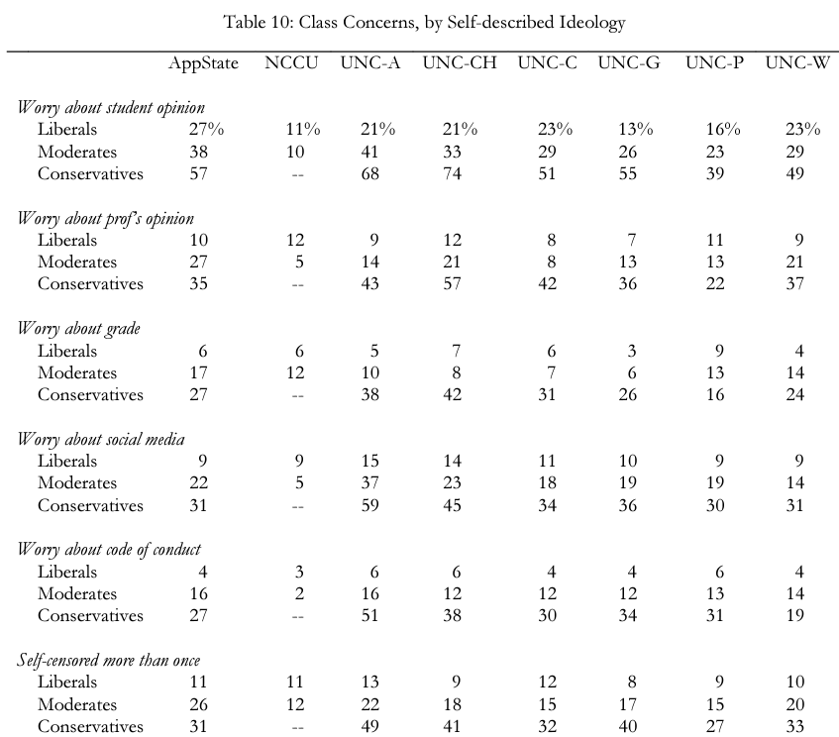
How we’re doing…
Finding 3: Students who identify as conservative face distinctive challenges.

Slide 11
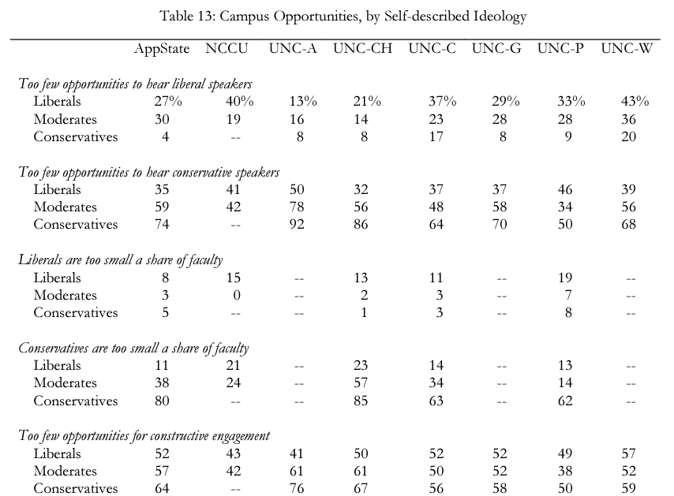
How we’re doing…
Finding 4: Students across the political spectrum want more opportunities to engage with those who think differently.
  Best “opportunities for constructive engagement” are in social settings, with fewer participants.
  Campus events should focus on consensus-building instead of an adversarial approach.

Slide 12
Next Steps
UNC Charlotte faculty and administration
  Consideration by faculty of adopting the “Chicago Statement” or similar expression of support for free speech principles
    Chicago statement: free speech policy statement produced by the Committee on Freedom of Expression at the U. of Chicago in 2015; endorsed by FIRE, adopted by UNC-CH, WSSU, and App St. faculty governing bodies
  Continue to support academic freedom in the classroom.
  Continued focus on promotion of events and speakers bringing diverse viewpoints
  Creation of a formal free speech policy incorporating any faculty and BOT commitments
  Support additional campus climate research/surveys tailored to UNC Charlotte
Other potential faculty considerations
  Including methodology and epistemology early in curricula
  Including free expression and viewpoint diversity as part of curricula
    Source: Campus Free Expression: A New Roadmap, Bipartisan Policy Center, November 2021

Slide 13
Next Steps
UNC Charlotte Board of Trustees
  Have expressed formal support of faculty’s exploration of adoption of Chicago Statement or similar expression of support for free speech principles
  Consider resolutions affirming UNC Charlotte’s free expression policies and practices
    UNC-CH BOT endorsed faculty adoption of the Chicago Statement as well as the 1967 U. of Chicago Kalven Committee “Report on the University's Role in Political and Social Action”
  Support efforts to defend free expression when controversies occur
  Support additional campus climate research/surveys tailored to UNC Charlotte
    Source: Campus Free Expression: A New Roadmap, Bipartisan Policy Center, November 2021

Slide 14

Questions and Discussion
e

